Slide 1

Black Cat 16
Release
NOVEMBER 2025

Slide 2
Black Cat 16
available since January 25th, 2026

Slide 3
What’s Coming with Black Cat 16
Overview
Business
Technical / configuration
Pricefx Agents enhancements
Leverage easy Agent creation through Pricefx Copilot, Agents’ Assessment dashboard, or self-service Agents’ deployment
Win Rate
Empower your price decisions with deal win-rate predictions based on recent quotes and get relevant deal-specific price recommendations.
Pricing Insights dashboards
Utilize Pricefx Copilot-powered set of dashboards for pricing professionals, including embedded AI Optimization models
Self-service dashboards - preview
Create dashboards that perfectly align with business views on data that matter to you, with intuitive setup and no coding
Import Manager
Add, update and export data, including their validation, with the Excel Client alternative. New support for additional data types
Platform management improvements
Enhanced Low / No Code Integrations, improved event orchestration, and automated data validation for selected Pricefx capabilities
Low / no code integrations
Manage automated file-based data integrations (uploads / exports), now with improved monitoring and expert options

Slide 4
Availability and Preconditions
Capability | Preconditions | Level of effort
Pricefx Agents | Agents subscribed, and Agents Accelerator deployed Analytics capability subscribed and Sales Insights Accelerator deployed and upgraded to the latest version | Low
Win-rate | Win-rate Accelerator deployed incl. its settings | Medium
Pricing Insights Dashboards | Pricing Insights Dashboards Accelerator deployed incl. Setting | Low
Import Manager | No preconditions | Low
Low / No Code Integrations | PlatformManager and IntegrationManager in use with the latest version | Low
Platform Enhancements | PlatformManager and IntegrationManager in use with the latest version | Low

Slide 5
Pricefx Agents
Enhancements

Slide 6
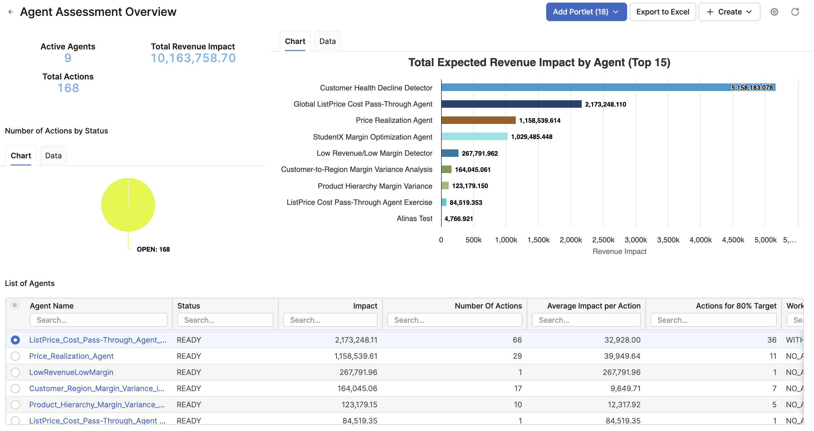
Pricefx Agents
Pricefx Agents
+
Your own tailored agents
Uncover business opportunities and risks on the fly
Utilize Agents’ automation to identify business opportunities and risks immediately
Get recommendations and act fast
Leverage the provided smart recommendations to capture resulting value with a few clicks
125+ Pricefx Agents
Start in <5 days with Pricefx Agents, designed for typical business scenarios and pricing situations
Tailored agents
Just ask Pricefx Copilot to create tailored Agent for your specific needs, while using just natural language

Slide 7








Pricefx Agents Organized to Groups
Across key pricing business problems
Margin Leakage
Price Harmony
Correct unprofitable products/customers
Stop costly pricing inconsistencies
Discount Strategy
Governance & Compliance
Eliminate non-targeted discounting
Enforce pricing and approvals policies
Upside Opportunity
Quote Intelligence
Uncover price lift potential
Remove quote speed-accuracy blockers
Account Optimization
Competitive Readiness
Drive better outcomes from at-risk account
Detect signals to defend market share
Portfolio Optimizer
Align price and product strategy

Slide 8
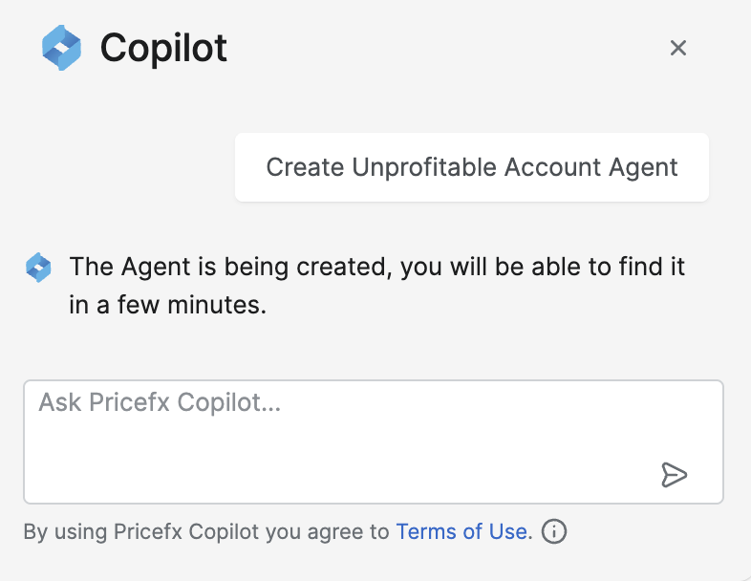
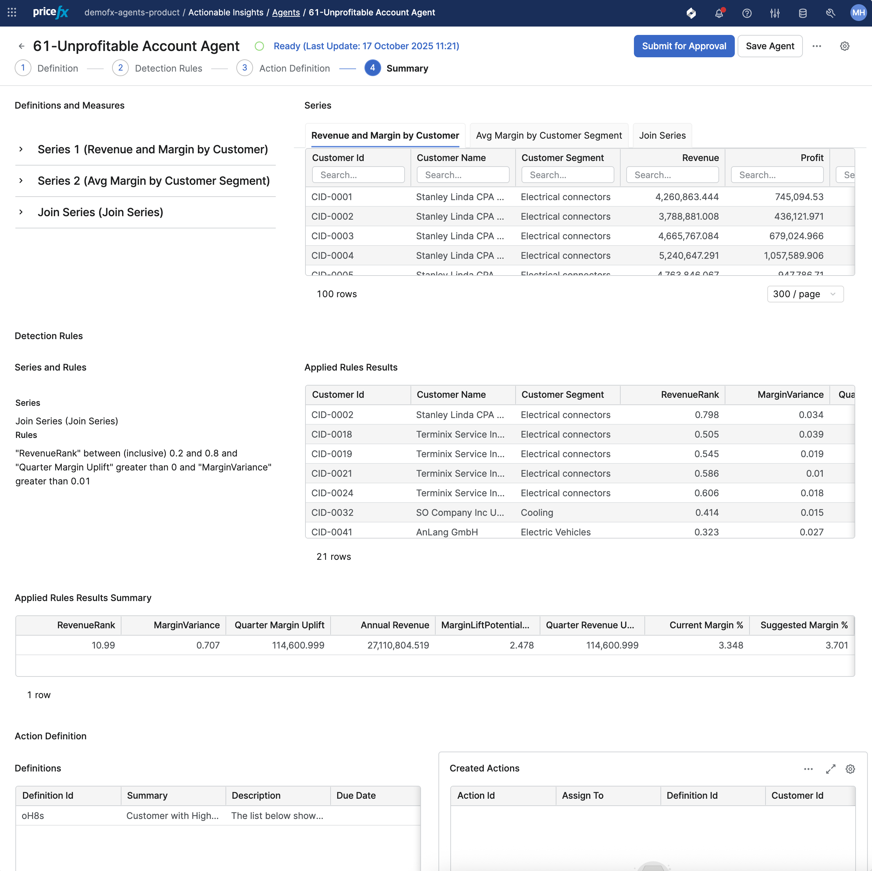
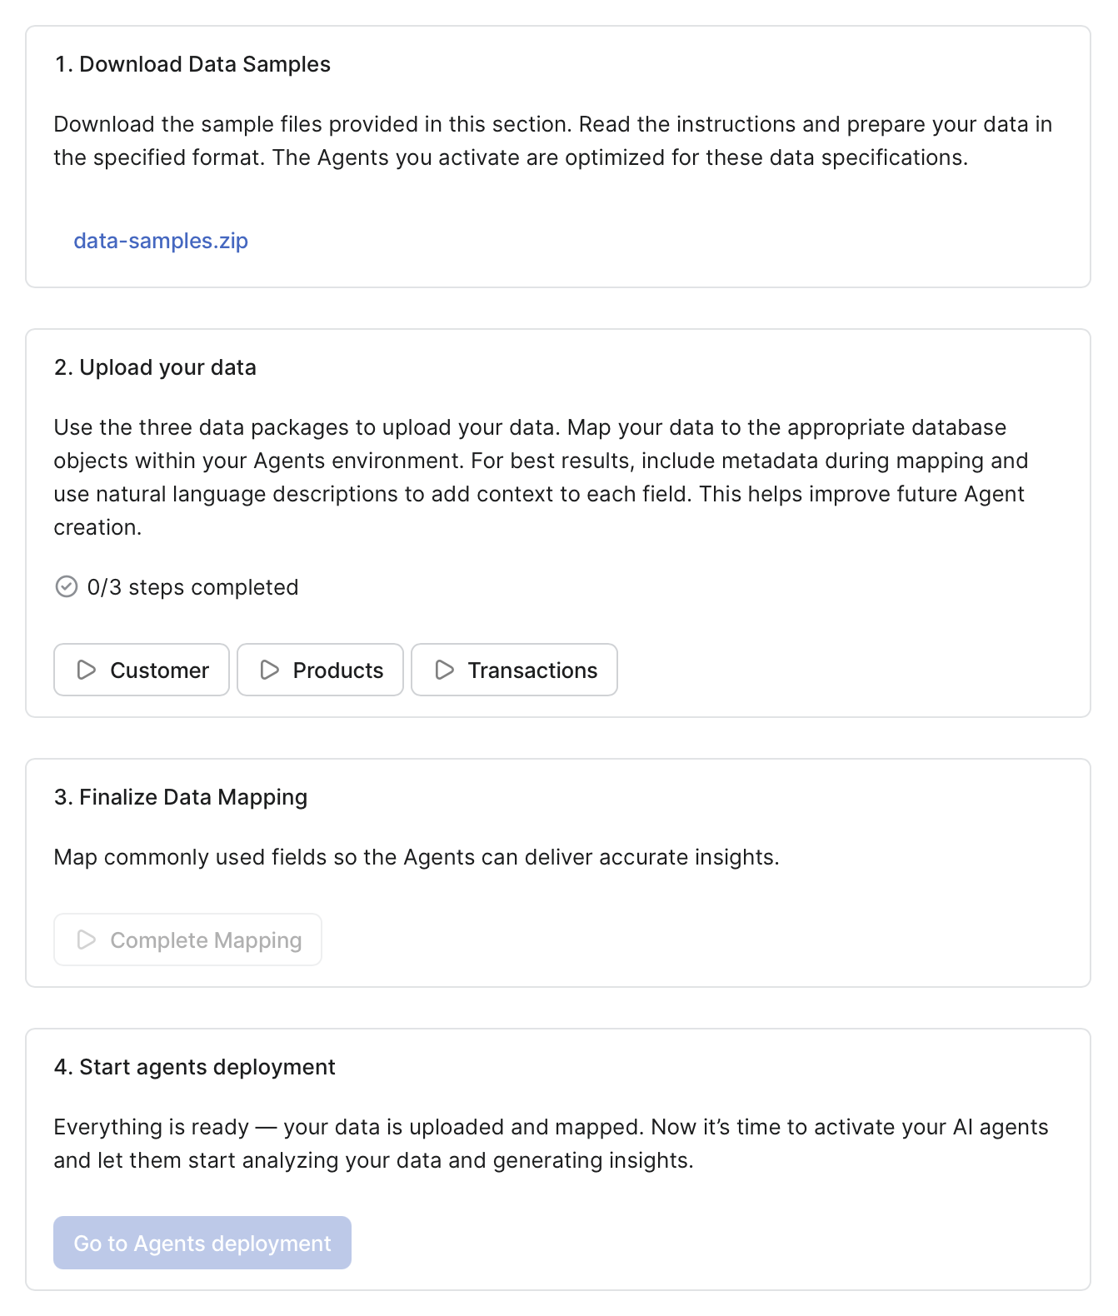
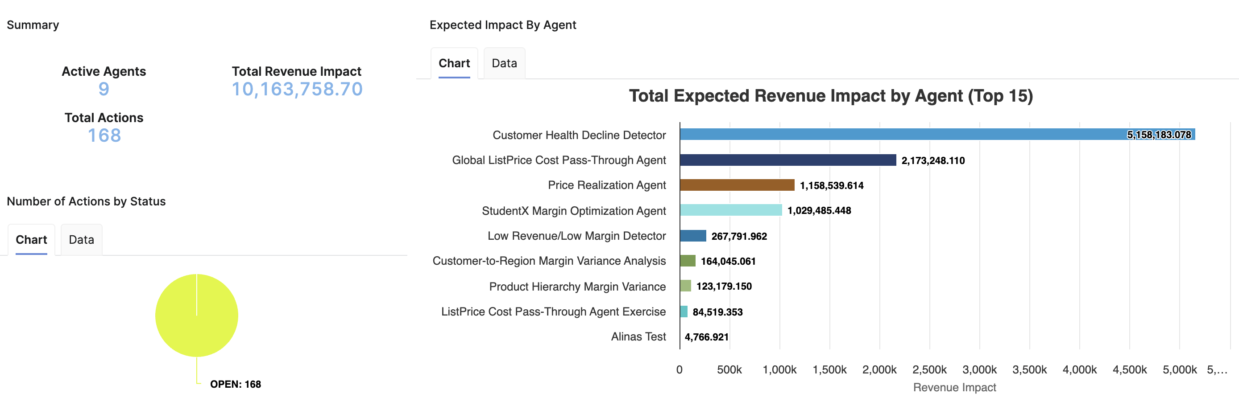
The Latest Enhancements
Tailored Agents, Agent Assessment dashboard, Self-service deployment
Agents created via Pricefx Copilot
Deploy Pricefx Agents
Create tailored Agents while using just natural language to describe your need
Agent Assessment dashboard
Evaluate business impact of Agents in place and quickly learn what to focus on to get most of the value quickly
Self-service deployment
Start with Agents in a self-service way, through simple data upload and mapping process

Slide 9
Agents Created with Pricefx Copilot
Create Agents in seconds while using just natural language
New agents created with chat experience
Pricefx Copilot can deploy Pricefx Agents or create tailored Agents for your specific needs
While using just natural language, you can describe your need, and the Agent will be generated by our AI in seconds
Agents are ready for your use incl. data definitions, thresholds and actions; details can be fine-tuned in Agent’s setting

Slide 10
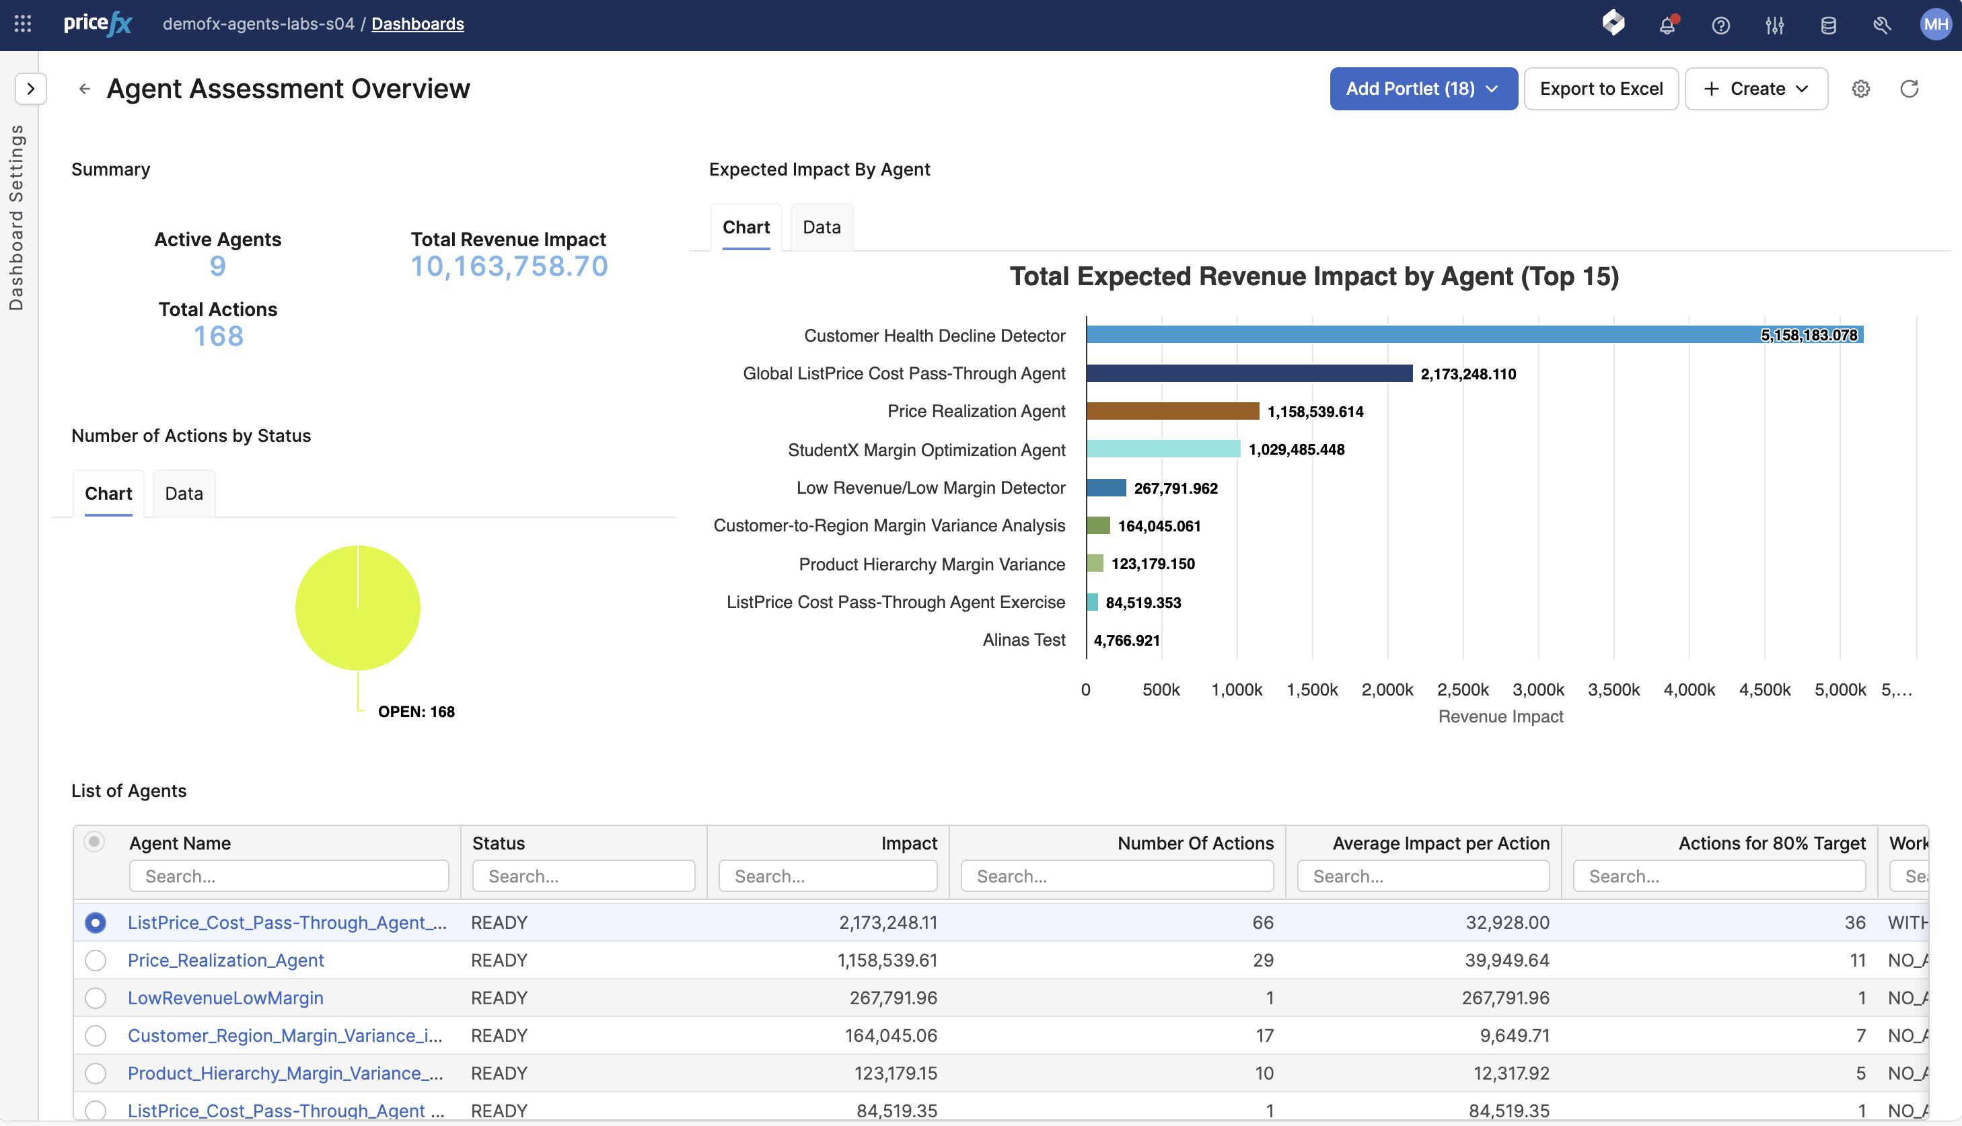
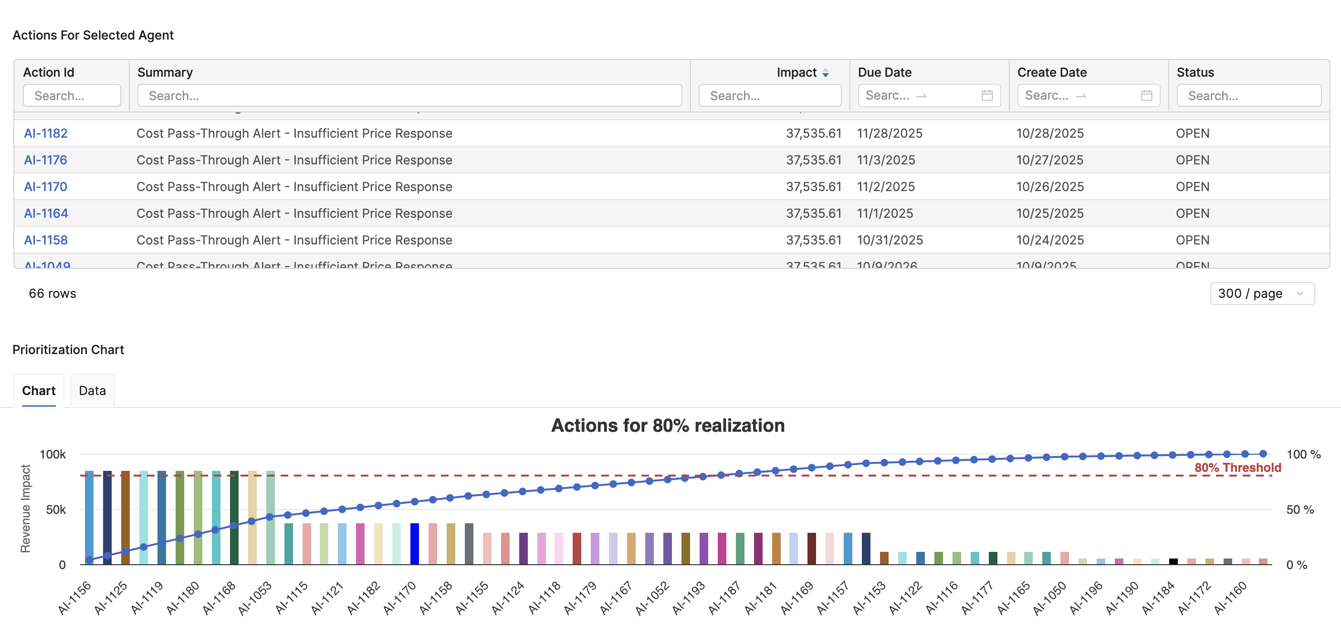
Agent Assessment Dashboard
Business impact evaluation for Agents in place
Evaluate business impact of your Agents
Get overview of Agents in place and potential business impact of their Actions
Availability of overall impact analysis vs. Agent-specific analysis
Learn what to focus on to get most of the value quickly
Leverage business impact analysis to prioritize your efforts accordingly and maximize value gained

Slide 11
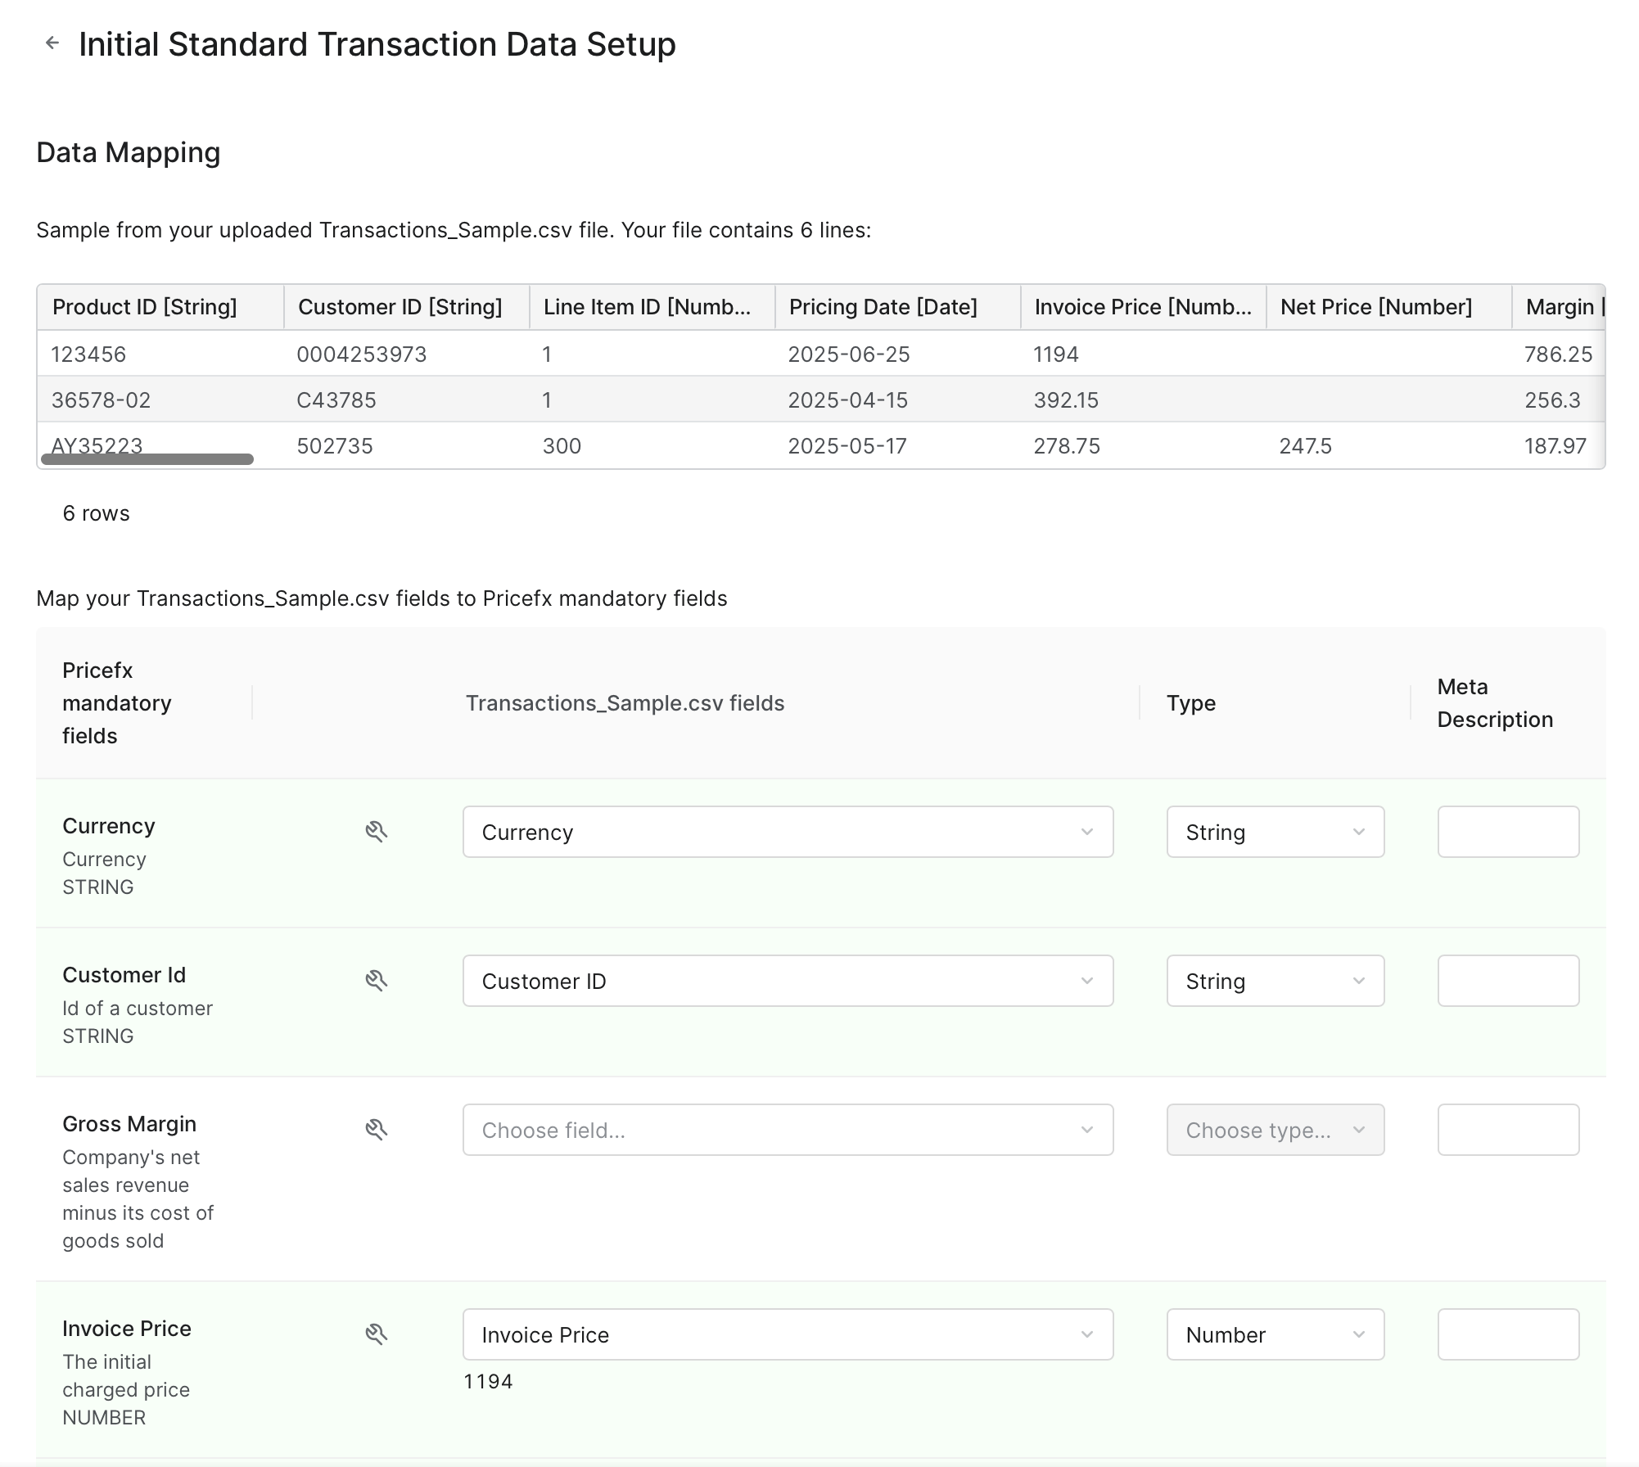
Self-Service Deployment of Agents
Start using Agents with simple data upload and mapping process
Start with Pricefx Agents on your own
Simple and intuitive process guiding you through the Pricefx Agents setup
Automated partition deployment
Data upload and mapping for product, customer and sales transactional data
Automated validation of uploaded data (formats, consistency, …)
Designed for new Pricefx deployments

Slide 12
AI Optimization
Win Rate

Slide 13
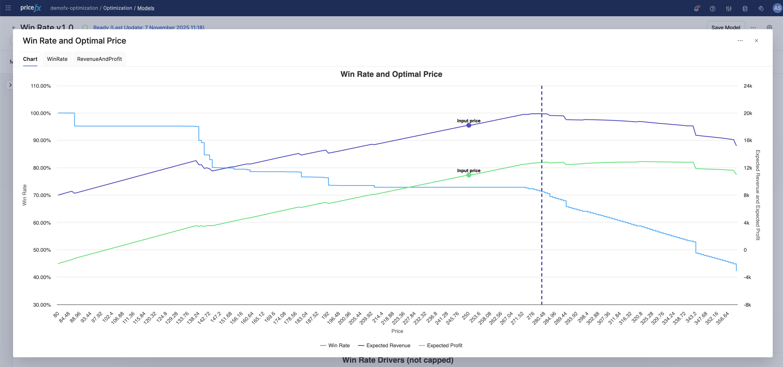
Win Rate
Understand what wins in real time
Gain insights from past quote outcomes—both won and lost—to identify what led to successful deals, with visual analytics that reveal how factors such as product availability or region impact win rates and enable faster market response
Optimize quoting decisions
Use deal context like customer type or deal size to get recommended prices that balance margin and win probability
Empower your sales team
Sales reps get instant win-rate scores and price recommendations tailored to each quote — helping them focus on what sells, adjust pricing smartly, and close more deals with confidence

Slide 14
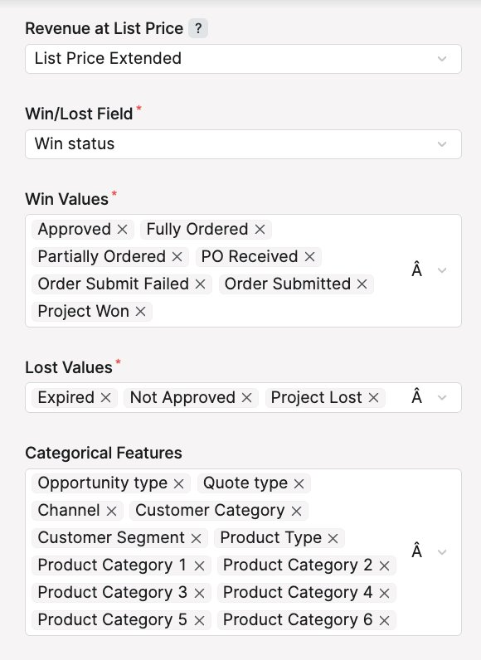
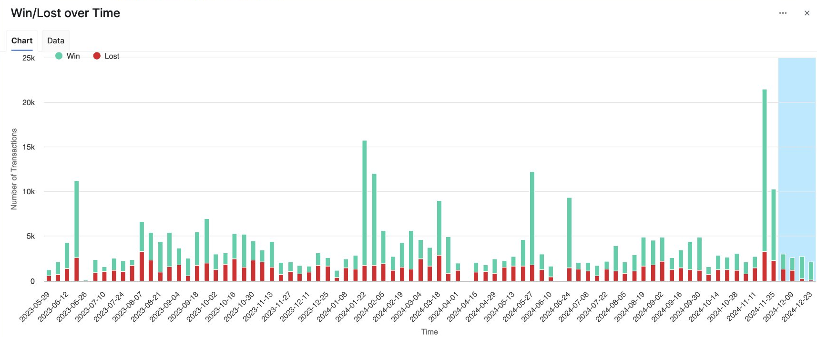
Quote-Level & Item-Level Intelligence
Turn quote data into ready-to-use sales guidance
Score win probability at item level
Help sales teams focus on what wins
By identifying which quote items consistently lead to successful deals, reps can prioritize high-performing products and accelerate revenue
Analyze quote outcomes at deal level
Turn past quote performance into pricing advantage.
By analyzing won/lost quotes, pricing teams can uncover patterns that drive success and refine future strategies

Slide 15
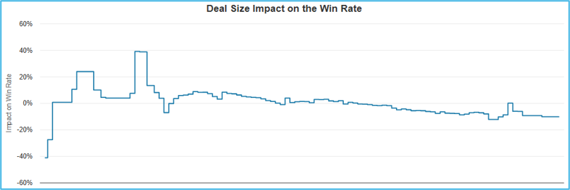
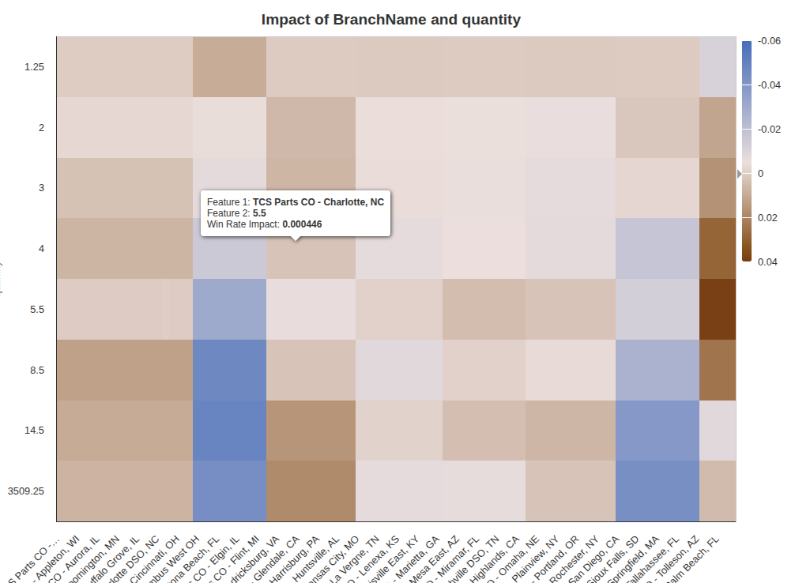
Optimize Pricing
Adapt your strategy
Optimize pricing with deal size & ratio
Drive smarter quoting decisions. Understand the importance of each item in a quote to tailor pricing for high-value opportunities and adjust your strategy when performance differs significantly between small and large deals
Optimize profitability
Balance margin and conversion. Test pricing strategies to find the optimal mix of win rate, revenue, and profitability—supporting confident decision-making

Slide 16
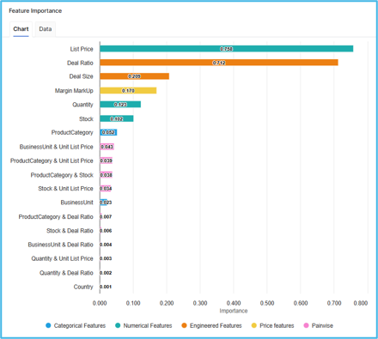
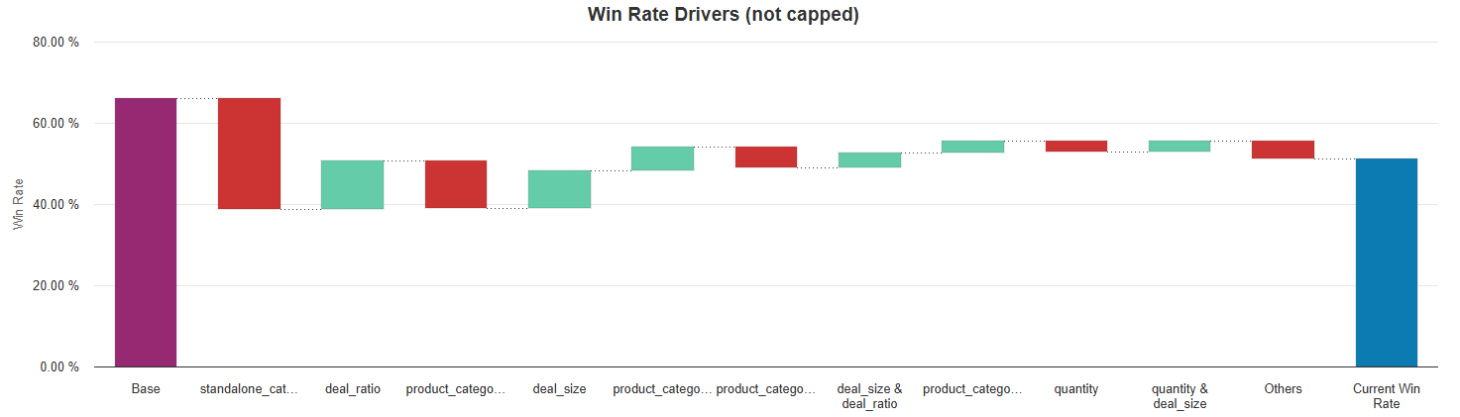
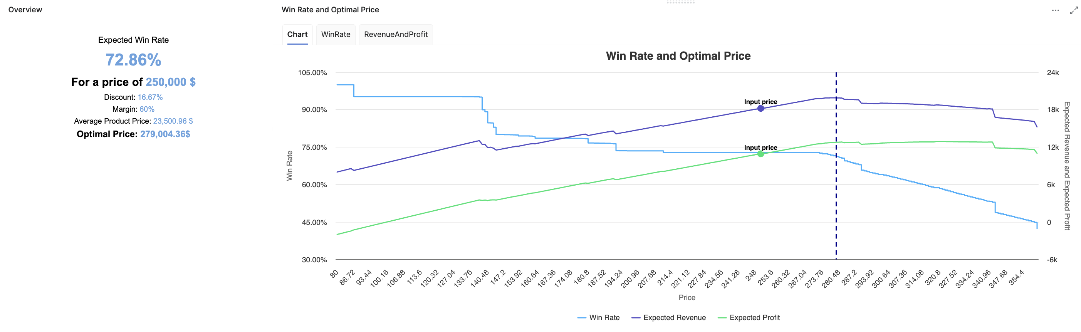
Contextual Pricing & Strategic Insights
Empower pricing and sales teams with deeper market understanding
Leverage broader deal attributes
Reveal hidden drivers of success by analyzing factors like product availability, competitors, or region — and turn these insights into action in three powerful ways:
  Quickly identify which deal attributes have the greatest impact on win rate
  Understand how changes to specific deal elements can influence your chances of winning
  Get clear, deal-specific explanations and take targeted action to improve your odds
Deliver insights with embedded dashboards
Turn insights into action. Visualize how market dynamics and quote context impact win rates—empowering both sales reps and pricing managers with data-driven guidance

Slide 17
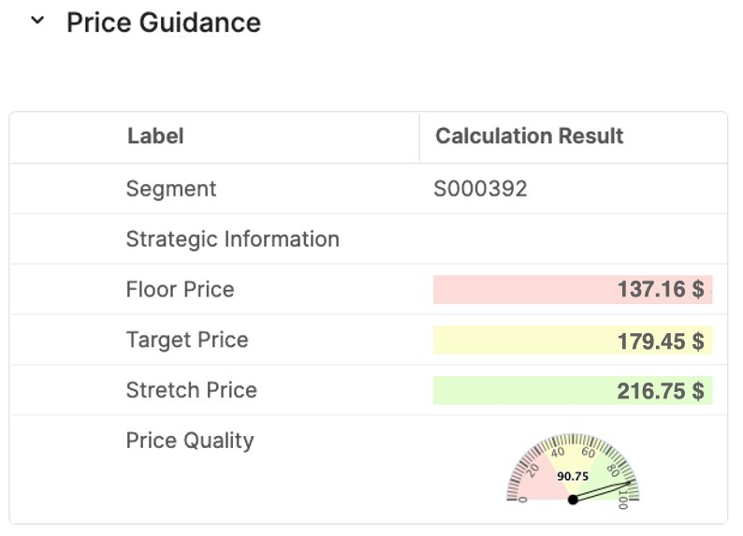
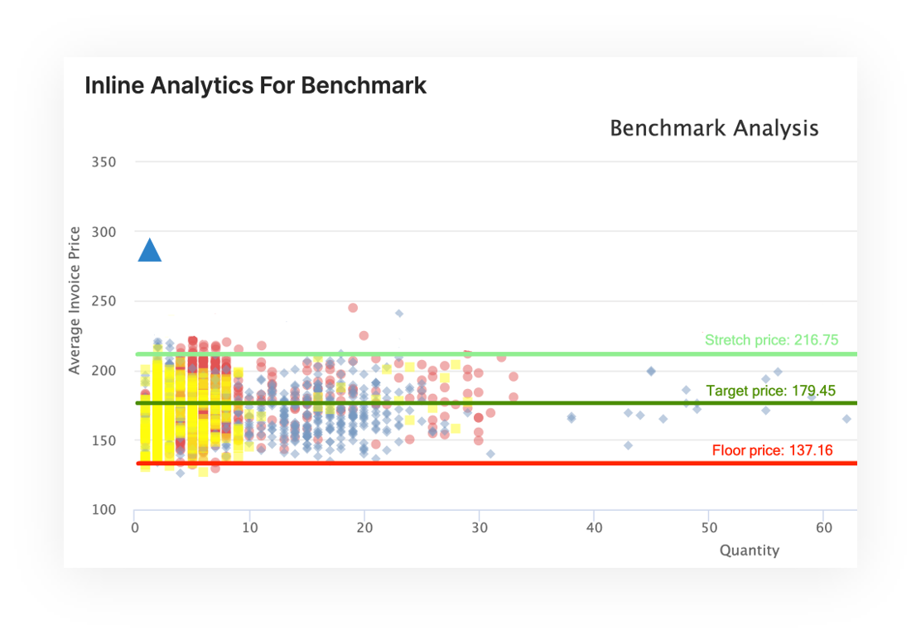
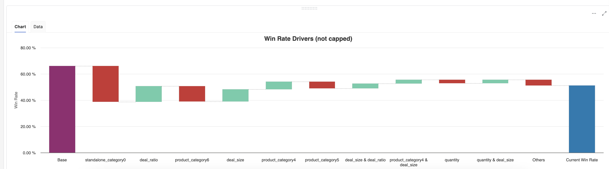
Win Rate & Negotiation Guidance Synergy
Boost win rates while aligning pricing with strategy—simultaneously
Win Rate helps you drive deal success
Negotiation Guidance delivers guardrails to protect strategy
Understand deal drivers: Evaluates historical quote-level data (win/loss) outcomes to uncover what drives deal success, analyzing market dynamics and deal context
Prioritize winning items: Helps sales reps focus on high-impact items with higher win probability
Leverage context: Provides market insights (e.g., product availability, regional trends) and includes quote context (e.g., customer, product, deal size, or ratio)
Real-time price guardrails: Real-time pricing recommendation used during quoting provides sales reps with price guardrails based on customer and product segmentation using transactional data
Consistent strategic pricing: Ensures consistent and optimized pricing for every quote aligning pricing with business goals (e. g. margin growth, volume increase)
Faster and better results: Improves margin and win rate through better price quality and quoting speed

Slide 18
Pricing Insights Dashboards

Slide 19
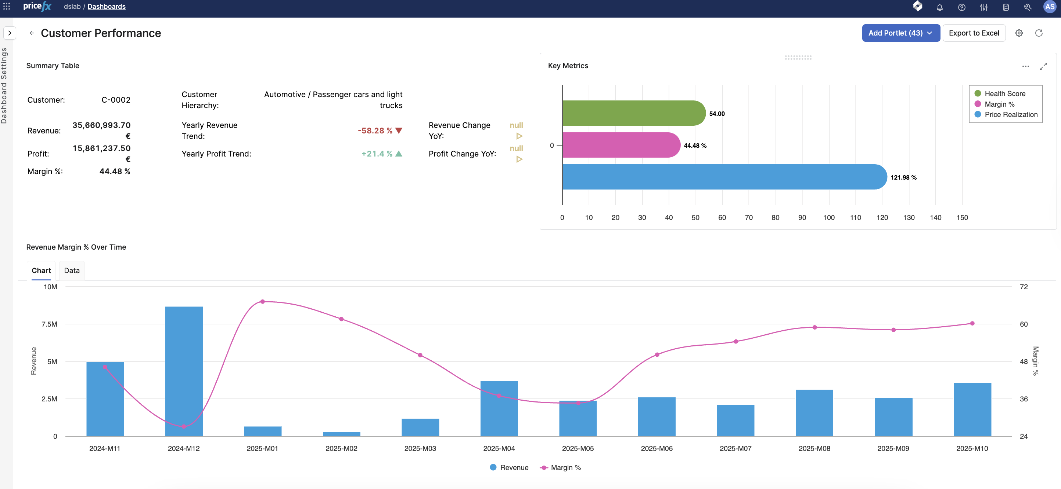
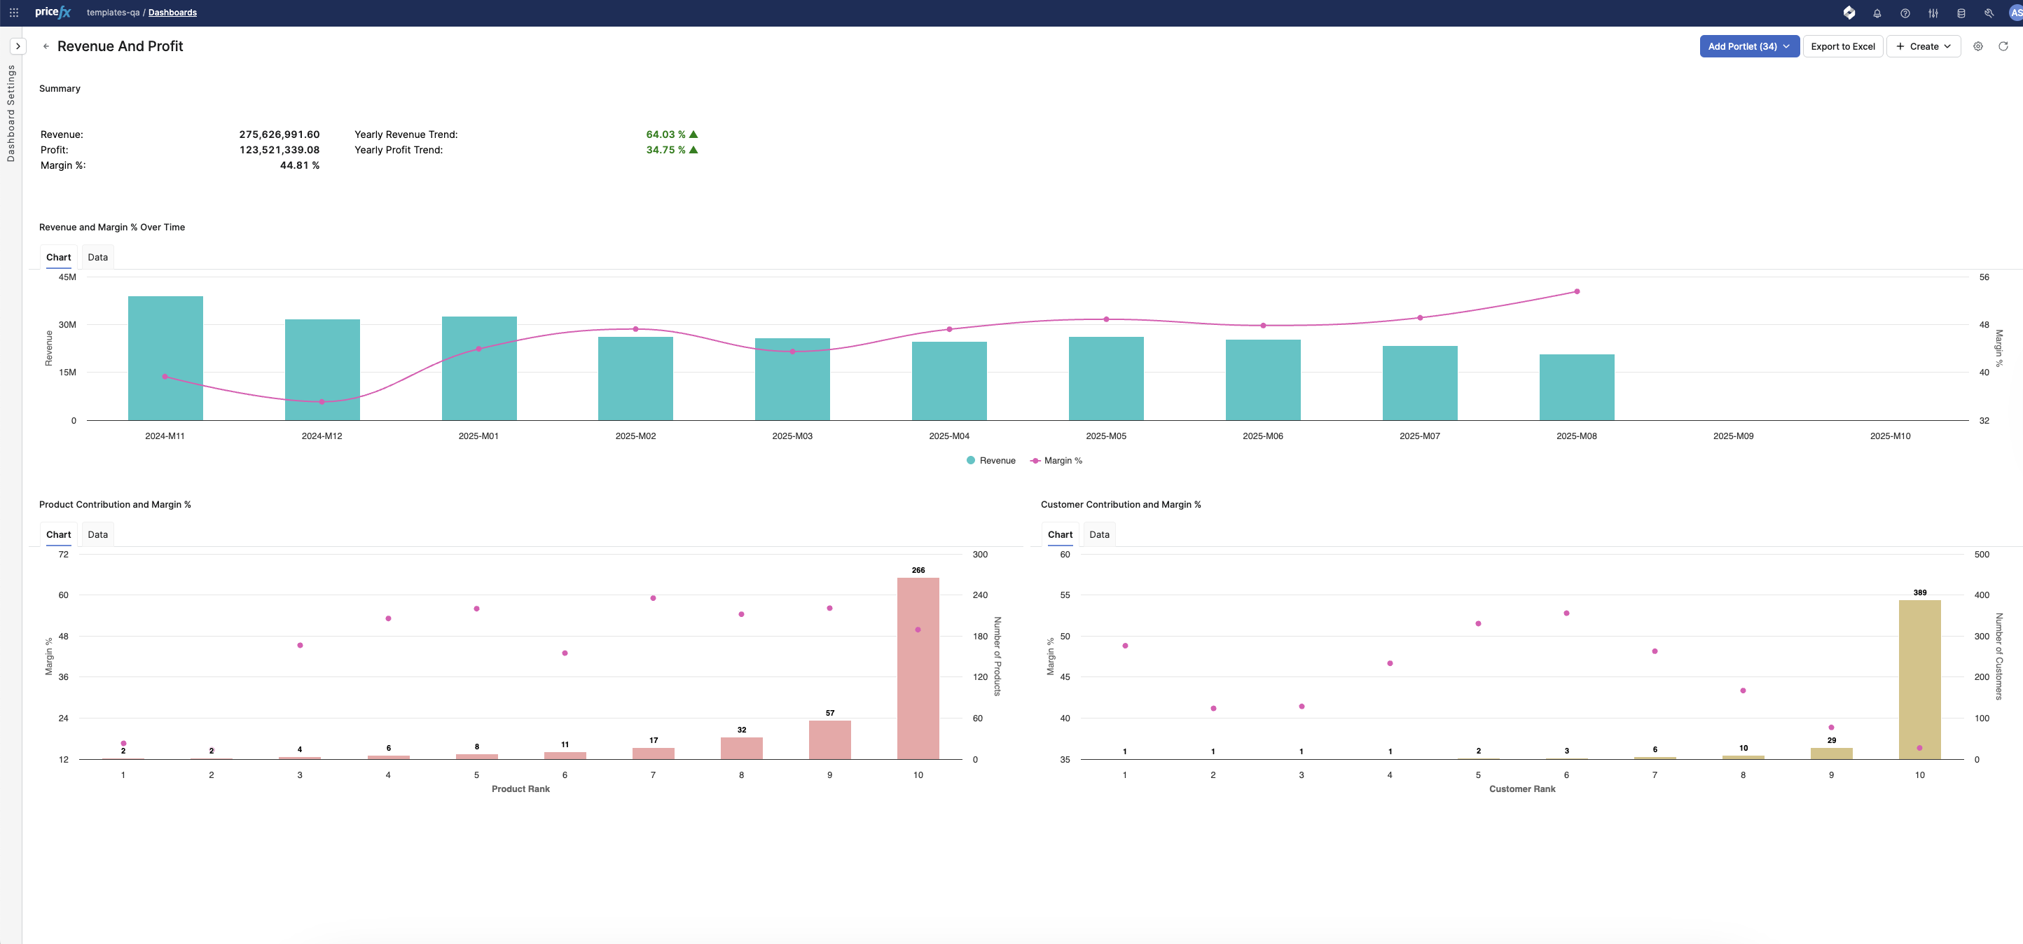
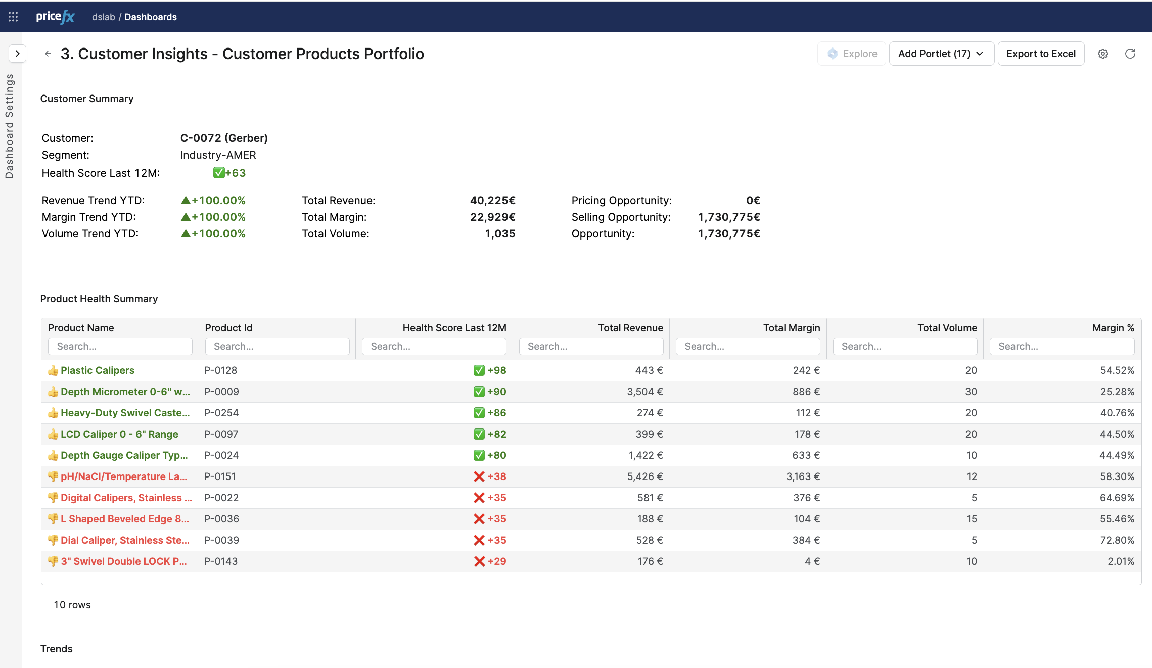
Pricing Insights Dashboards
Empower pricing teams with insights
Purpose-built dashboards deliver the insights pricing teams need — from financial visibility to driving smarter decisions
Streamline pricing analysis workflows
Connected dashboards guide users through a seamless flow — from high-level views to detailed insights — making it easy to navigate, analyze, and act — all in one flow
Turn insights into actions
Pricefx Copilot recommends the next best steps based on real-time data. With integrated Pricefx Agents, you can act instantly — without switching tools or losing context

Slide 20
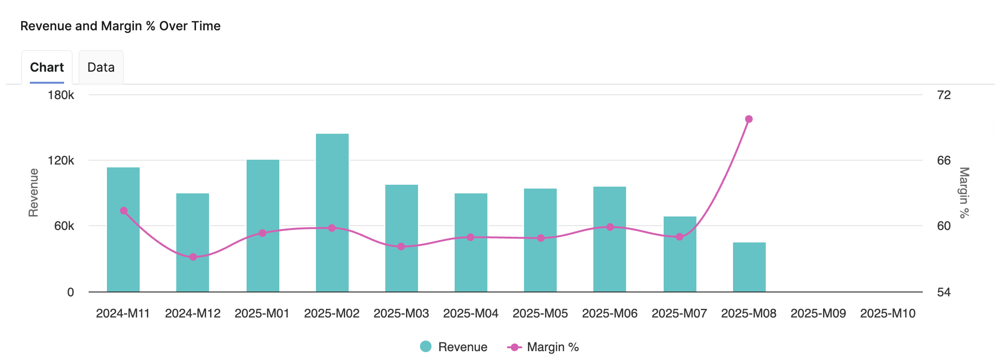
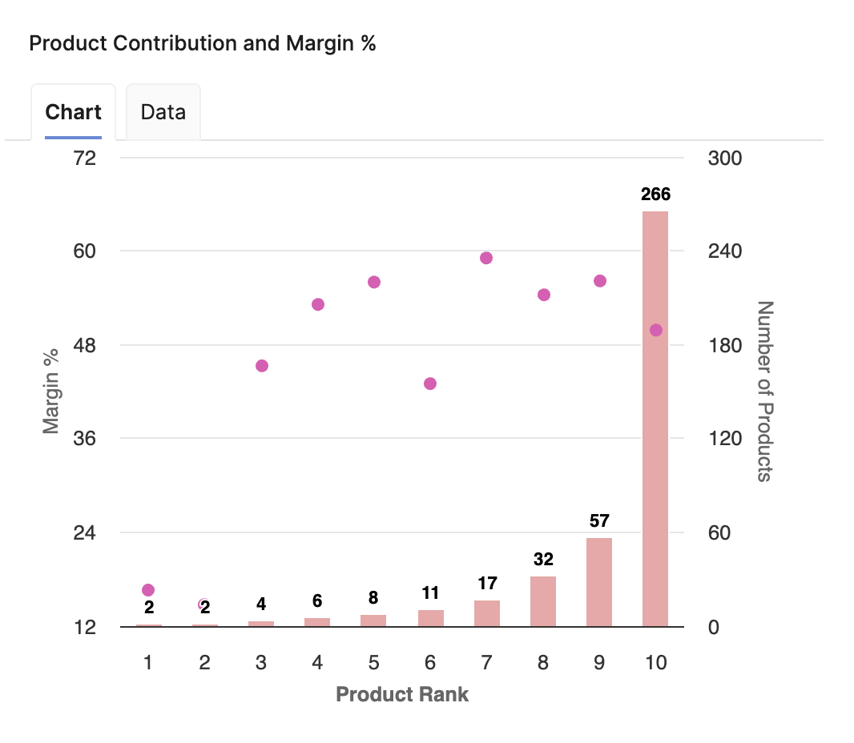
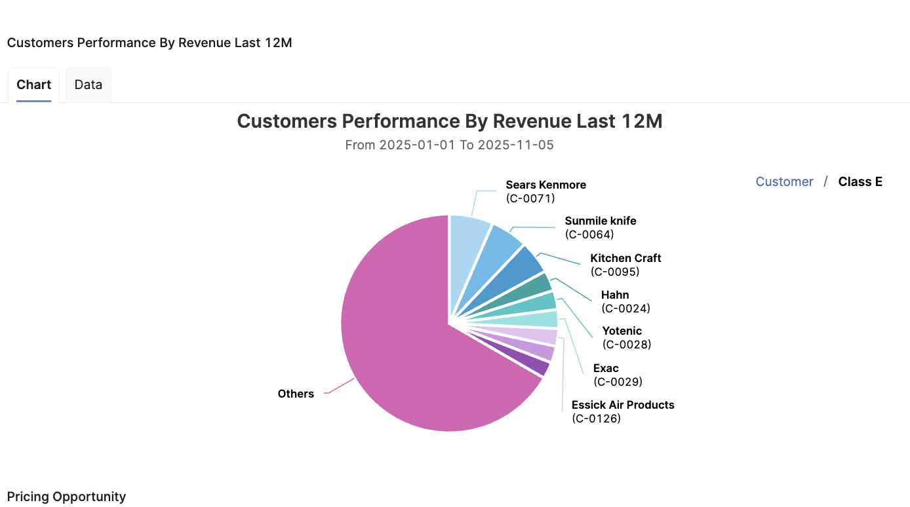
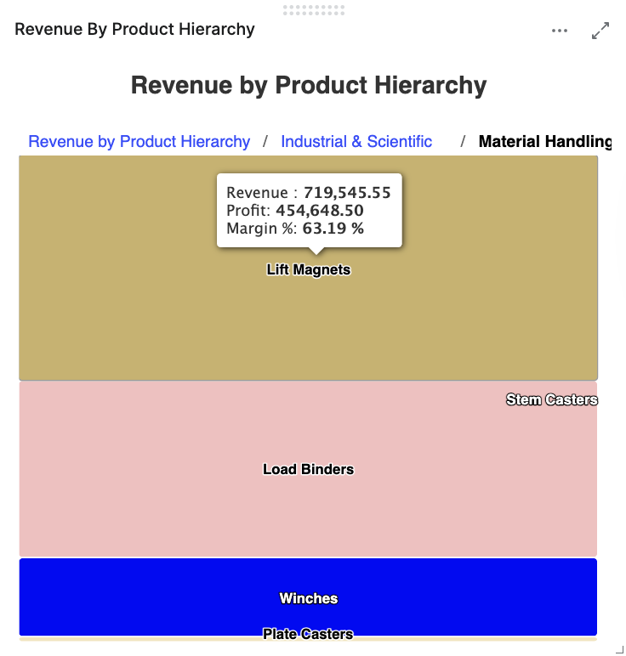
Navigate Pricing Insights with Flow
Dashboards are designed to reflect how pricing teams work
Workflow-aligned navigation
Dashboards are connected in a step-by-step flow — from Revenue & Margin to Product Performance
Guiding you through the pricing process in a way that reflects how they actually work
Seamless context linking
Filters and selections are automatically carried across dashboards
Enables consistent analysis without losing focus or reapplying inputs
From high level to details
Start with a high-level view
Drill down to specific customers, products, or transactions in just a few clicks

Slide 21
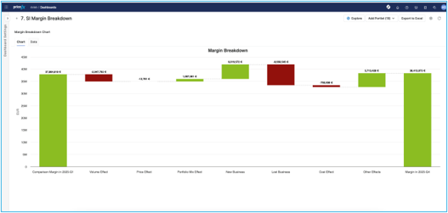
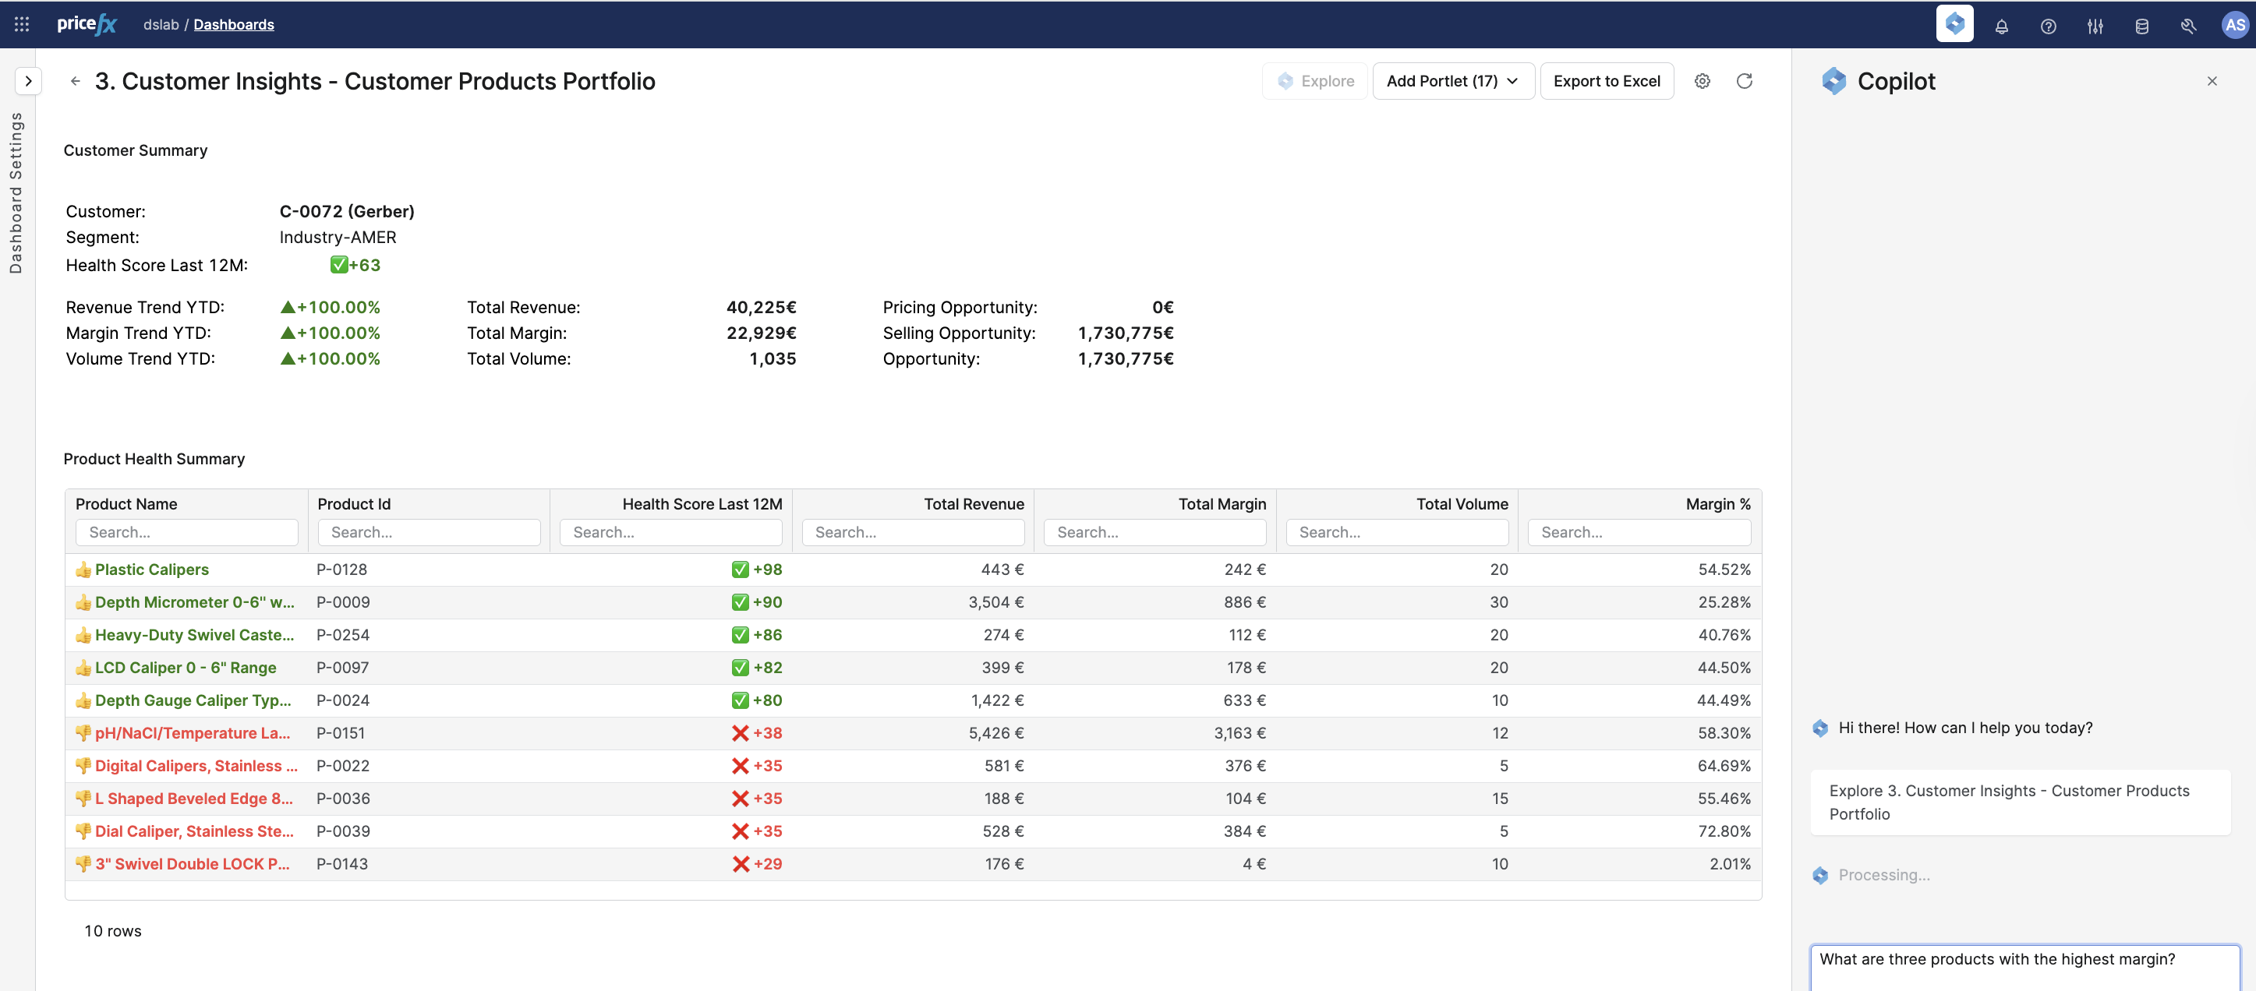
From Insight to Actions
Seamless connection with Pricefx Copilot or Agents
Pricing opportunity dashboard
Spot opportunities to increase prices, cross-sell, or optimize
Guide sales to high-impact areas
Copilot-ready dashboards
Structured to support Copilot recommendations
Suggest next actions based on real-time insights — helping you act faster and with more confidence
Integrated with Agents
Trigger actions directly from dashboards using Pricefx Agents
Ensure insights leads to measurable outcomes

Slide 22
Import Manager

Slide 23
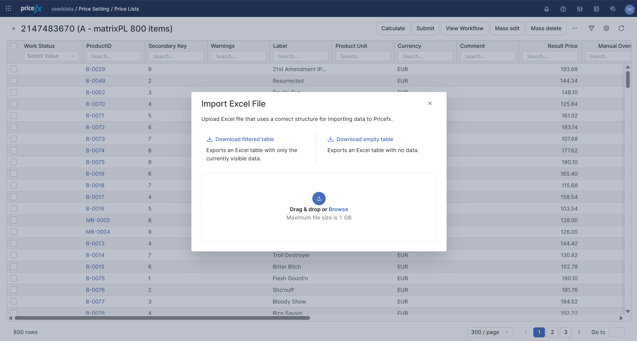
Import Manager
Enhance data management
Benefit from a simpler, more intuitive way to manage data in Pricefx. Export, import, or update directly within the application as an alternative to the Pricefx Excel Client
Import data across the application
Available for Price Lists or Live Price Grids data, Customer and Seller Master Data and Extensions, Products and Product Extensions without needing to open additional tools for a better experience
Now also available for Company Parameters, Manual Price List, Competition Data, Bill of Material, and Product Reference. Handle advanced datasets with ease.
Now available for advanced datasets such as company parameters

Slide 24
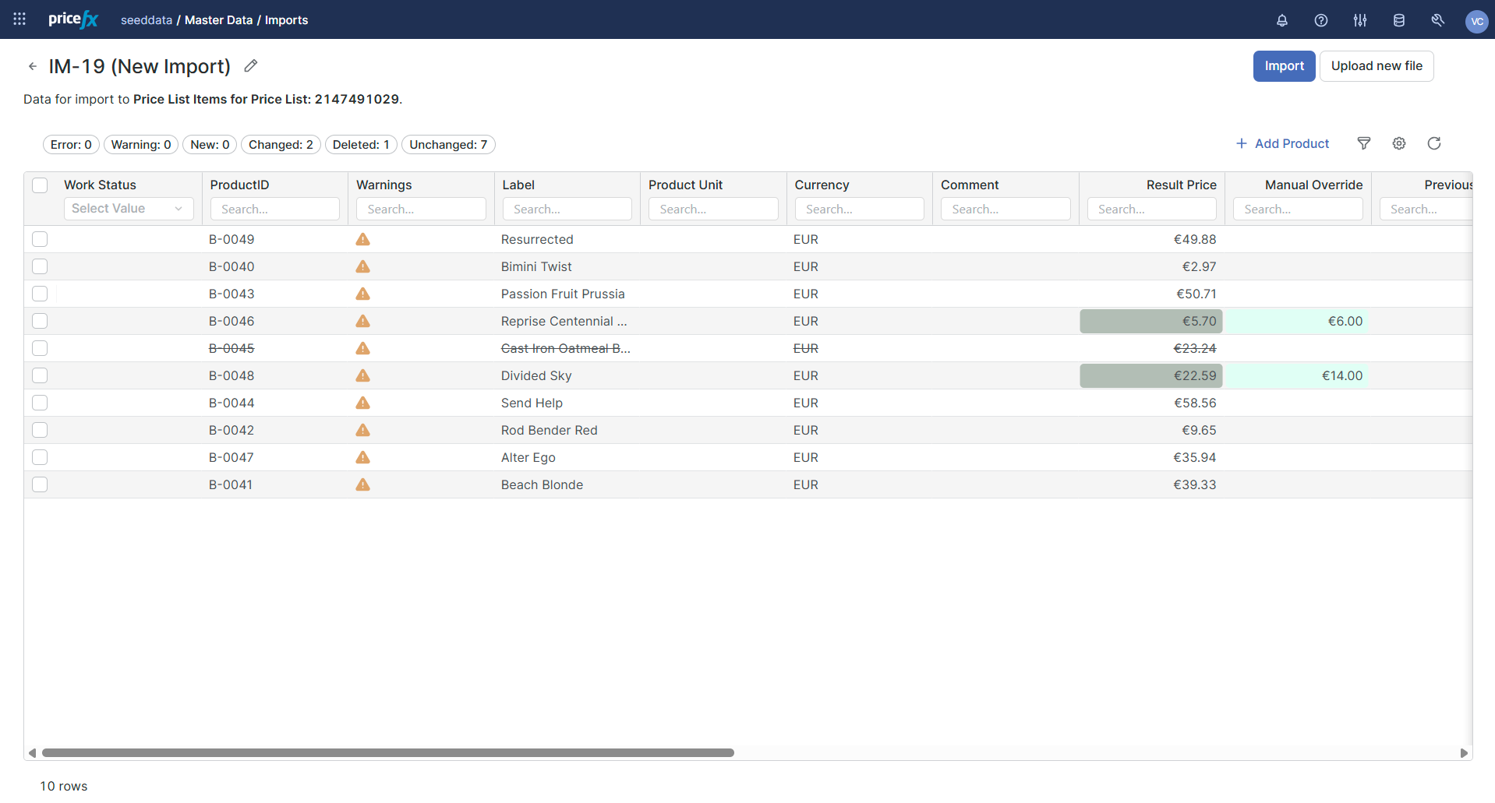
Comprehensive Capabilities of Import Manager
Work with data in a new way
In-app data management
Easily export, import, and modify data in the familiar Excel way with the in-app tool
Export and edit with ease
Export data, edit it in Excel, and upload it back to Pricefx
Build workflows that fit your data tables
Set up specific processes for each data entity and gain better control over your business logic
Designed to replace the Excel client
Import manager is the modern alternative to the Excel client, which is planned to reach end of life in June 2026

Slide 25
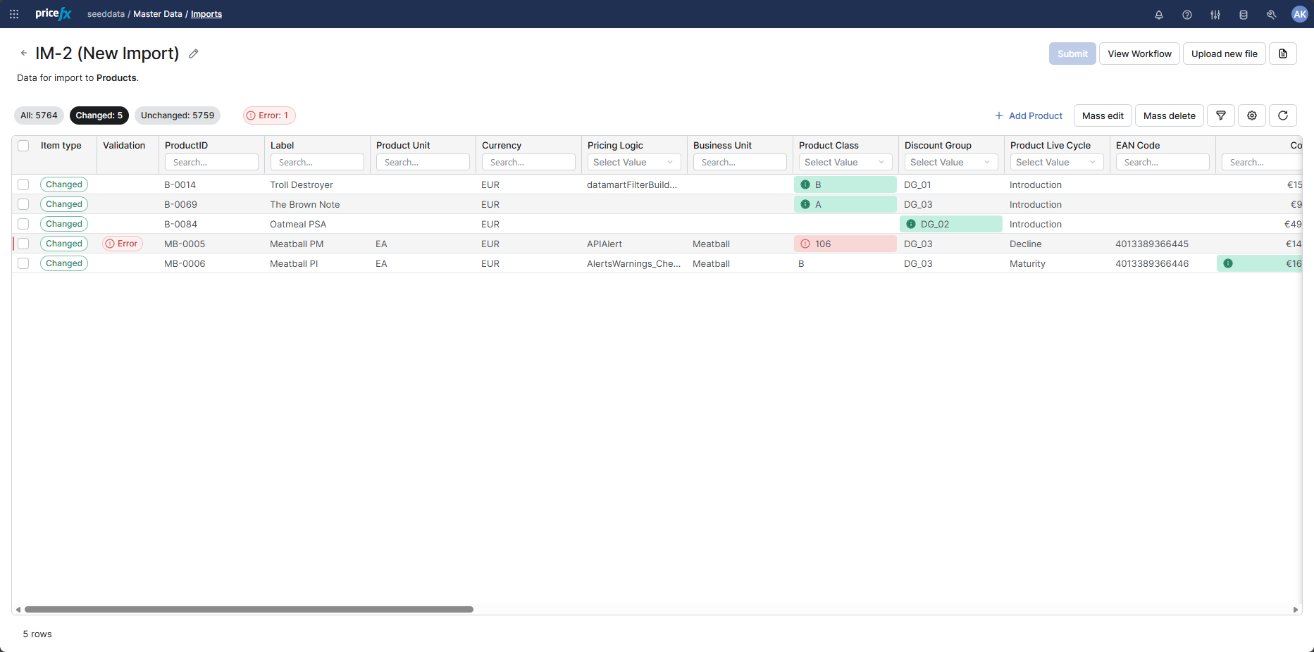
Comprehensive Capabilities of Import Manager
Take Control of Your Data Imports
Approval workflow integration
Ensure all imports are subject to approval through approval workflows
Controlled data manipulation
Review changes after import to identify mismatched rows before applying. Make bulk changes directly in the app without prior need for configuration
Company parameters support
They can now be imported using the same model and validation steps as other data types
Bulk editing in validation screen
Make mass edits and deletions directly within the import validation screen

Slide 26
Platform Management
Improvements

Slide 27
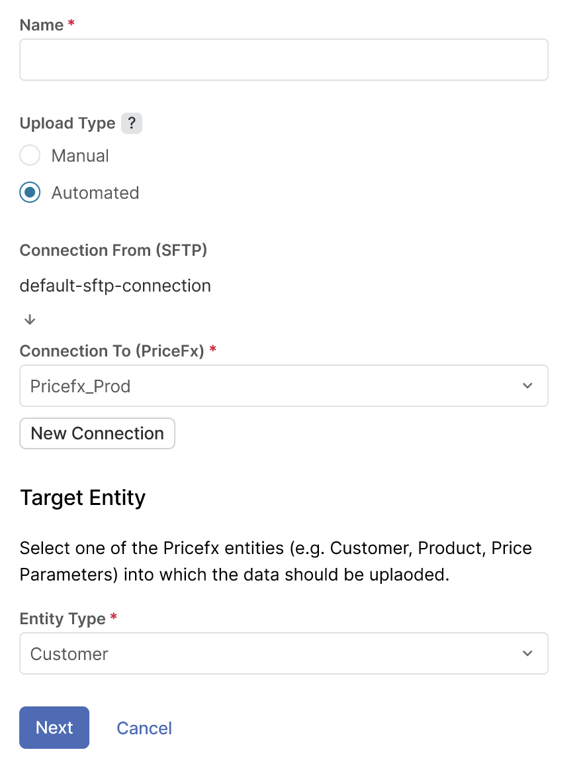
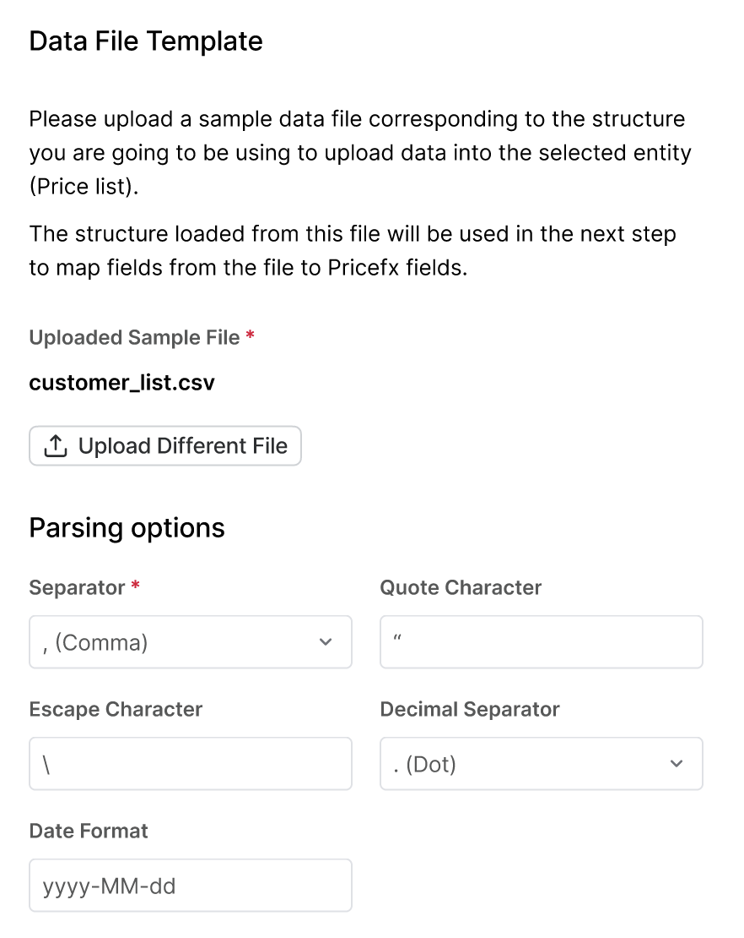
Platform Management Improvements
Enhanced low / no code integrations
Setup regular data uploads / exports without technical skills, now with improved monitoring and expert options (custom export names, multiple files export, scheduling, notifications)
Enhanced event orchestration
Stability improvements (now each customer has its own listener), new notification options, improvements to auditing
Data validation
Options to validate uploaded data for selected Pricefx capabilities

Slide 28
Low / No Code Integrations

Slide 29
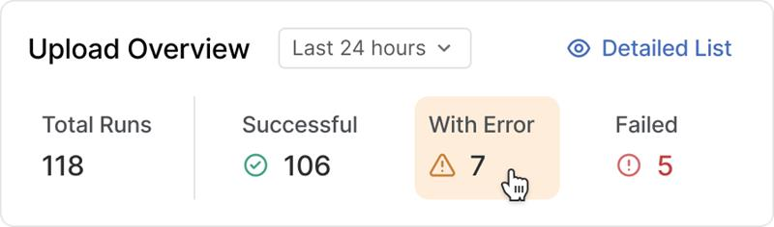
Low / No Code Integrations with Pricefx
Integrate data effortlessly
Enable seamless data integrations of Pricefx and other IT systems without advanced technical skills
Automate uploads and exports
Quickly set up automated file-based uploads or exports in just a few simple steps
Leverage advanced integration options
Utilize related options, such as SFTP connection management, data mapping, monitoring, archiving etc.
Drive your self-sufficiency in Pricefx
Available in PlatformManager with other options enabling self-service for Pricefx platform management

Slide 30
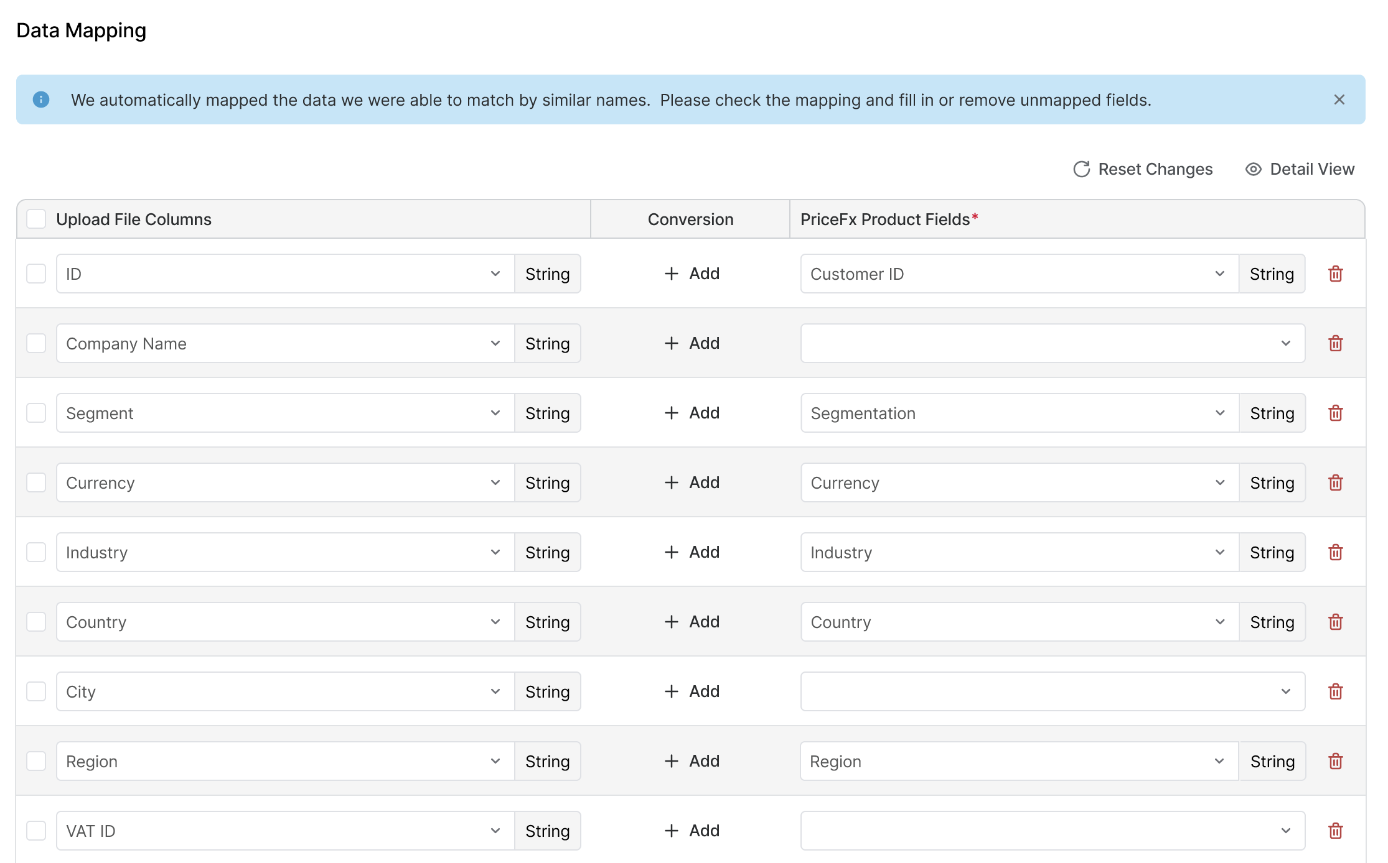
Integration Setup and Data Mapping
Set the source and target destination of the data
SFTP management
Quickly reuse or set up new SFTP connections to pinpoint external data locations
Data destination and purpose
Accurately define target locations within Pricefx and specify data types (customers, products etc.)
Automated mapping recommendations
Leverage automated recommendation for mapping source data to Pricefx data structures
Data mapping customization
Easily adjust data mappings, add missing elements, or ignore unnecessary attributes

Slide 31
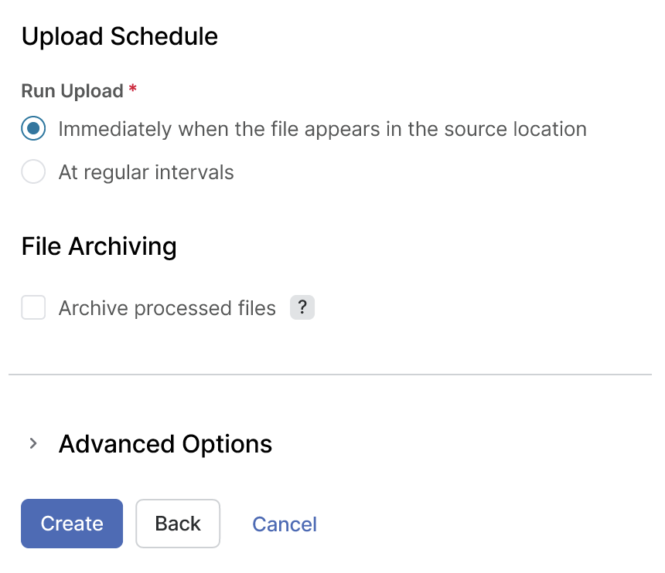
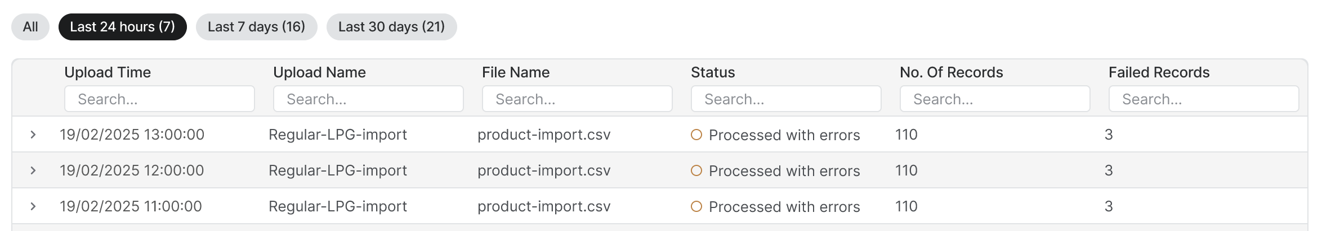
Settings and Monitoring
Set the frequency of uploads / exports and monitor the operation
Customize upload / export frequency
Set the frequency of data uploads or exports to match your precise needs
Data archiving
Request archiving of processed data whenever necessary
New expert options
Custom export names, multiple files export, scheduling, notifications
Improved monitoring
Gain visibility into automated upload and export runs at any time, ensuring transparency and control over data operations

Slide 32
Other Key Enhancements

Slide 33
Other Key Enhancements Coming with Black Cat
Dashboard Snapshots (available for early adopters)
Create scheduled, pre-calculated versions of your dashboards so you can open them instantly — no loading, no waiting. Ideal for recurring views like daily, weekly, or monthly reports
More attributes (columns) for Price Lists and Live Price Grids
Enabling attribute extensions for Price Lists and Live Price Grids to overcome the 100-column limitation
Visual Configuration - snippets within snippets and live preview
It’s now possible to use a snippet within another snippet, which increases flexibility and reusability. Live preview is now available for the Formula Designer (previously introduced also for the Price Strategy Designer)

Slide 34
Self-Service Dashboards
Preview

Slide 35
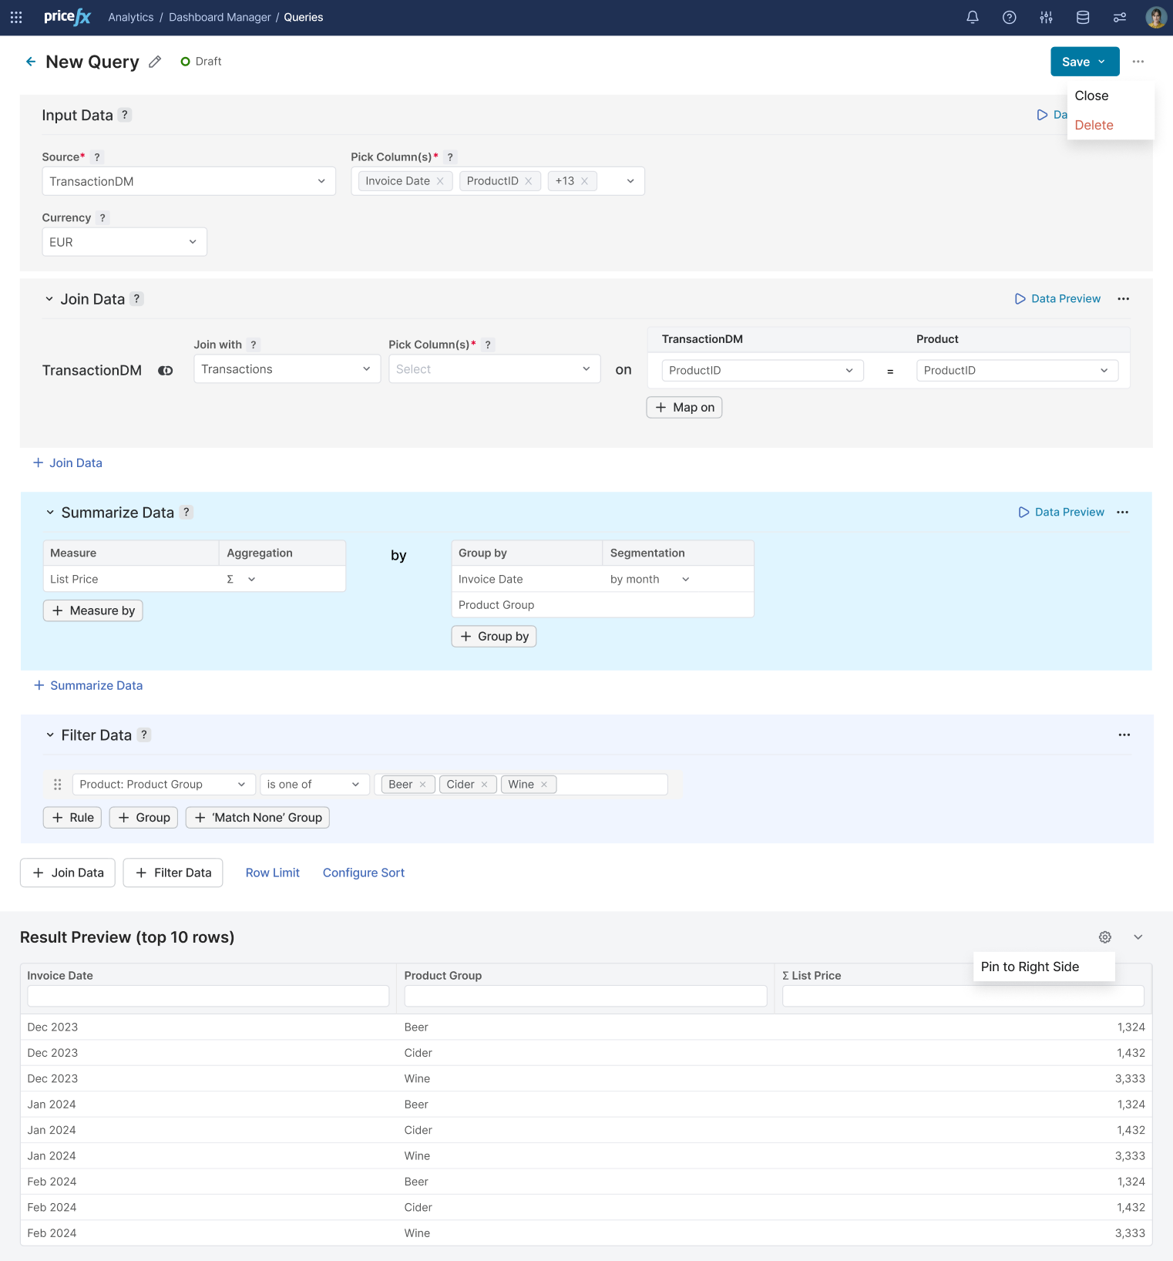
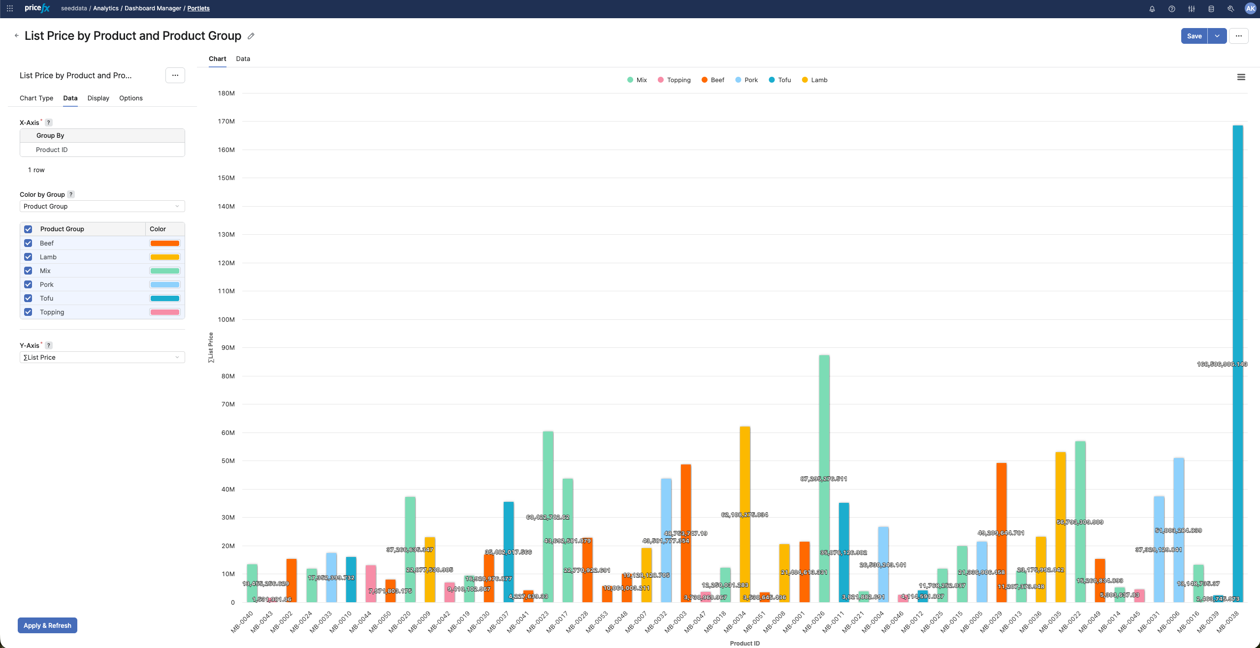
Self-Service Dashboards - Preview
Tailored to your business needs
Create dashboards that perfectly align with business views on data that matter to you
No technical skills required
Design your data views without advanced technical skills – no coding and intuitive setup
Effortless data queries
Easily setup data queries matching your specific needs, and visualize results through variety of chart types
Preview
Available for preview now (can be enabled through Feature Flags); General availability during 2026

Slide 36
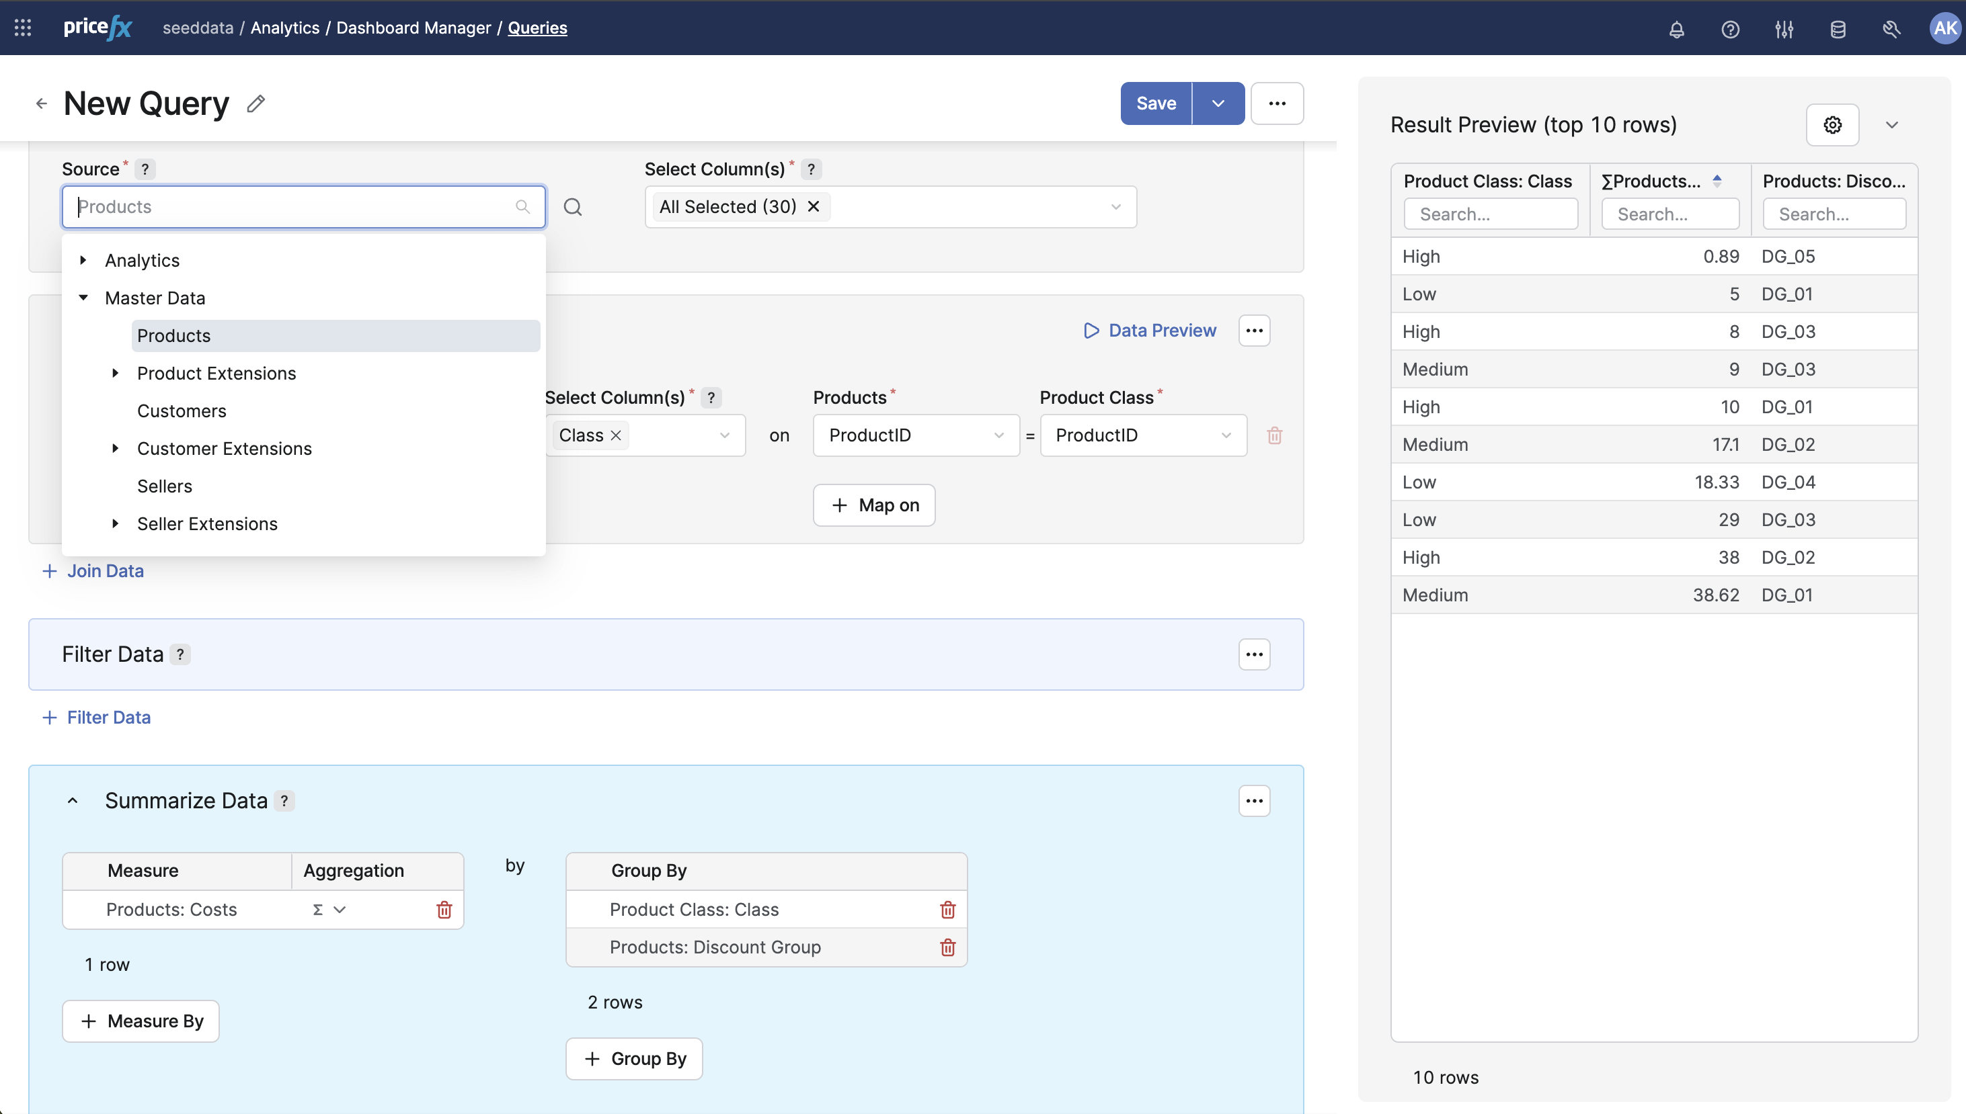
Easy Setup of the Data Queries
Setup data queries easily to visualize data that matter to you
Intuitive and no-code
Setup data queries for your business views without advanced technical skills and coding
Extended range of supported data
Analytical data
Selected Master Data (Products, Customers, Sellers, and their Extensions)
Query reusability
Define the query once and reuse it in different dashboards or visualizations

Slide 37
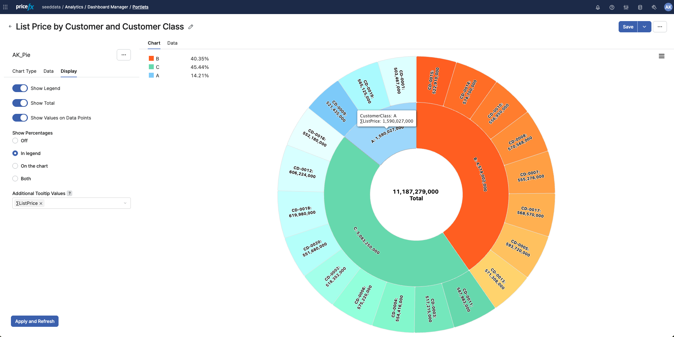
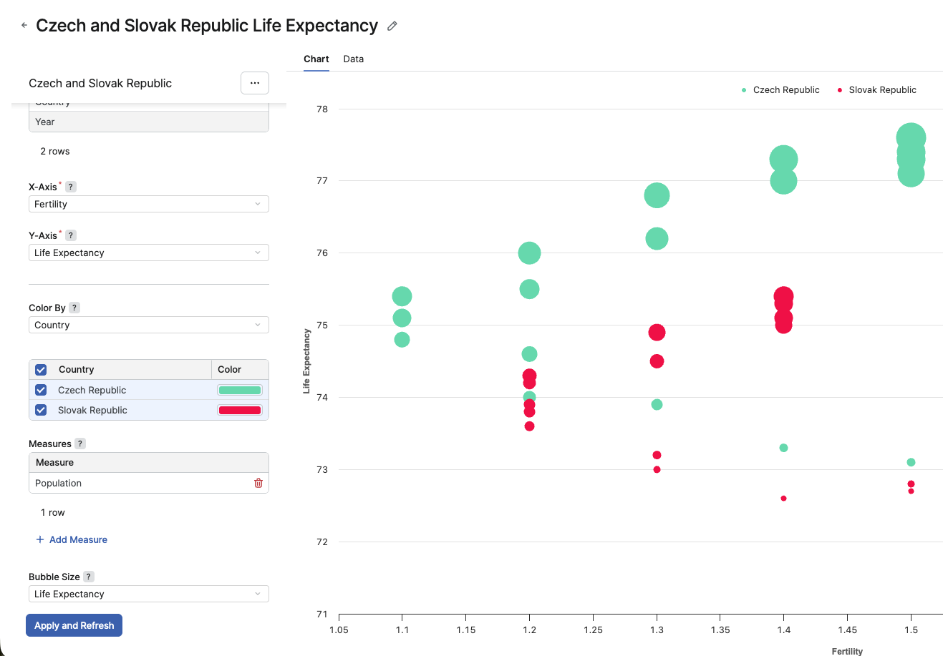
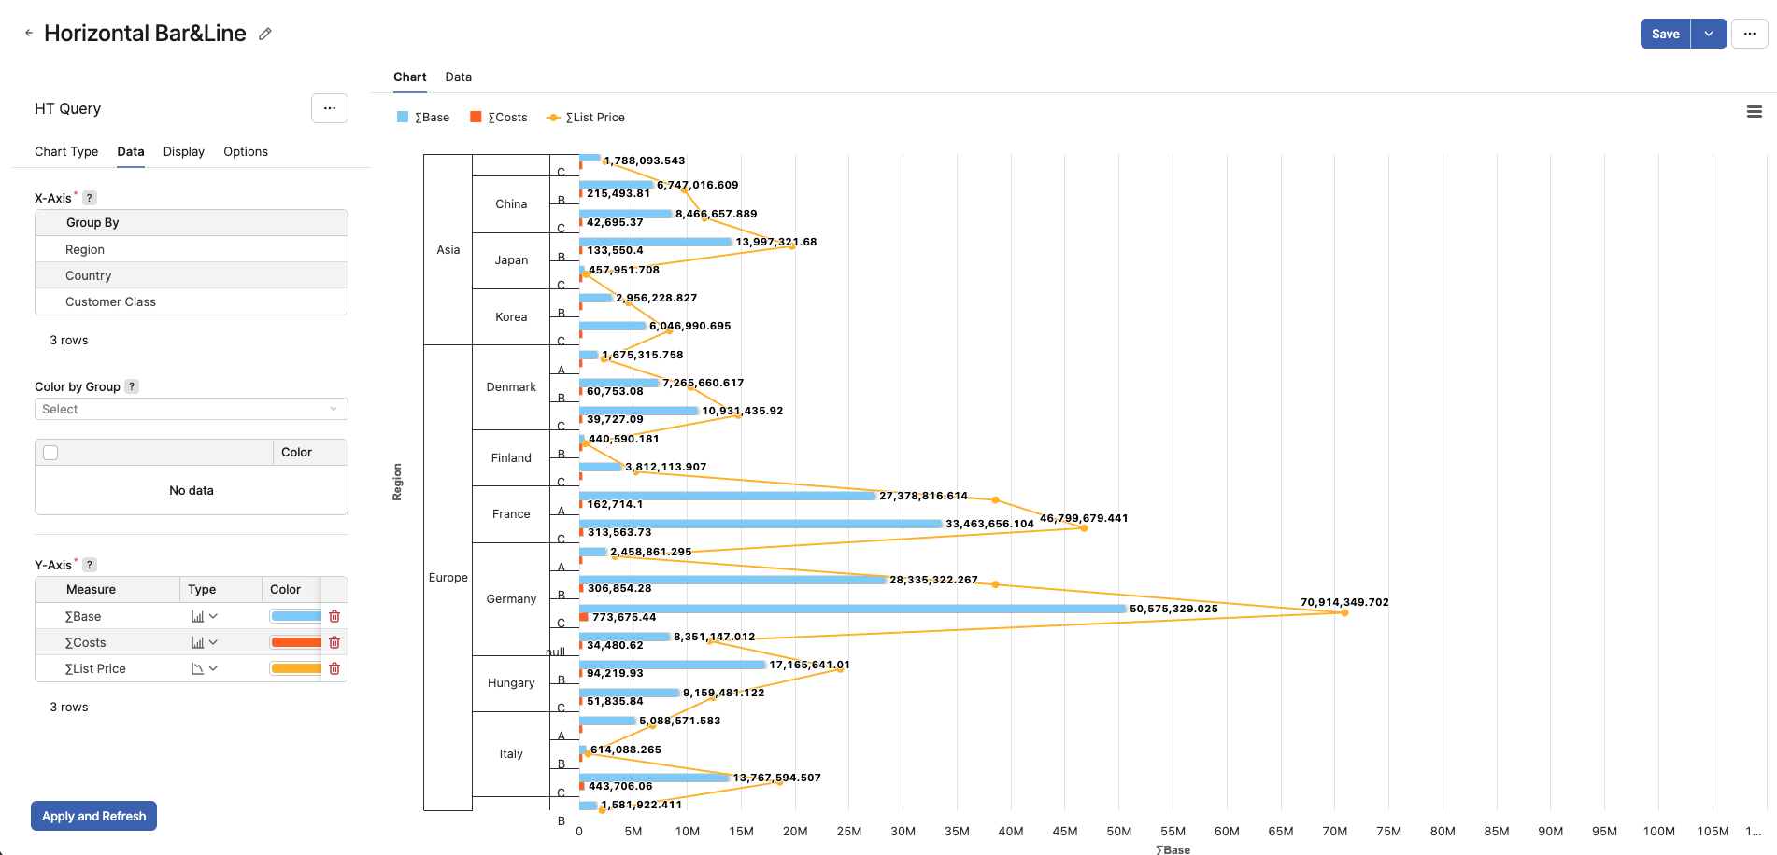
Supported Chart Types
Select relevant chart type to visualize your data meaningfully
Currently supported chart types
Data table
Bar & line
Scatter
Bubble
Pie

Slide 38
Pricefx N-1 Release Policy

Slide 39
Pricefx N-1 Release Policy
Pricefx provides official support for the latest 2 releases. Currently, Caribou Lou 14.x and Southside 15.x releases meet this condition
Once the Black Cat 16 release is made available, all our customers will be required to use either Black Cat 16.x (N release) or Southside 15.x (N-1 release)
If you are on the Caribou Lou 14 release, we encourage you to start planning for the upgrade to Southside 15 already now
Information important primarily for Customers hosted in Private cloud environments.
Customers hosted in Shared environment are upgraded automatically and comply with the policy.

