Slide 1

Paloma 17
Release
APRIL 2026

Slide 2
Pricefx Paloma 17 available since June 28th, 2026

Slide 3
What’s Coming with Paloma 17
Pricefx Agents and Copilot
AI Optimization
Import Manager
Speed up decision-making with Pricefx Agents’ Actions grouping and contextual Action Tasks. Involve multiple data sources when creating Pricefx Agents with Copilot.
Optimize your pricing strategically with the latest advancements of our Negotiation Guidance and List Price Optimization AI use cases.
Add, update, validate, and export data directly from within the Pricefx application. New support for direct imports without approvals and in-app import creation.
Other Enhancements
New Knowledge Base
Deprecating Features
Save time with scheduled pre-calculation of dashboards, background recalculation of documents, or validate data files in PlatformManager.
Search faster in all-new Pricefx Knowledge Base with embedded AI chatbot and MCP access.
The Pricefx Excel client and Data Change Request will be deprecated and fully replaced by the Import Manager.

Slide 4
Availability and Preconditions
Capability | Preconditions | Level of Effort
Pricefx Agents and Copilot | Agents Accelerator deployed / upgraded Copilot enabled Sales Insights Accelerator deployed / upgraded | Low
Negotiation Guidance | Negotiation Guidance Accelerator deployed / upgraded | Medium
List Price Optimization | List Price Optimization Accelerator deployed / upgraded | Medium
Import Manager | No preconditions | Low
Data Validation in PlatformManager | PlatformManager and IntegrationManager in use with the latest version | Low
Dashboard Snapshots | No preconditions | Low
Knowledge Base | No preconditions | Low

Slide 5


Pricefx Agents and Copilot

Slide 6
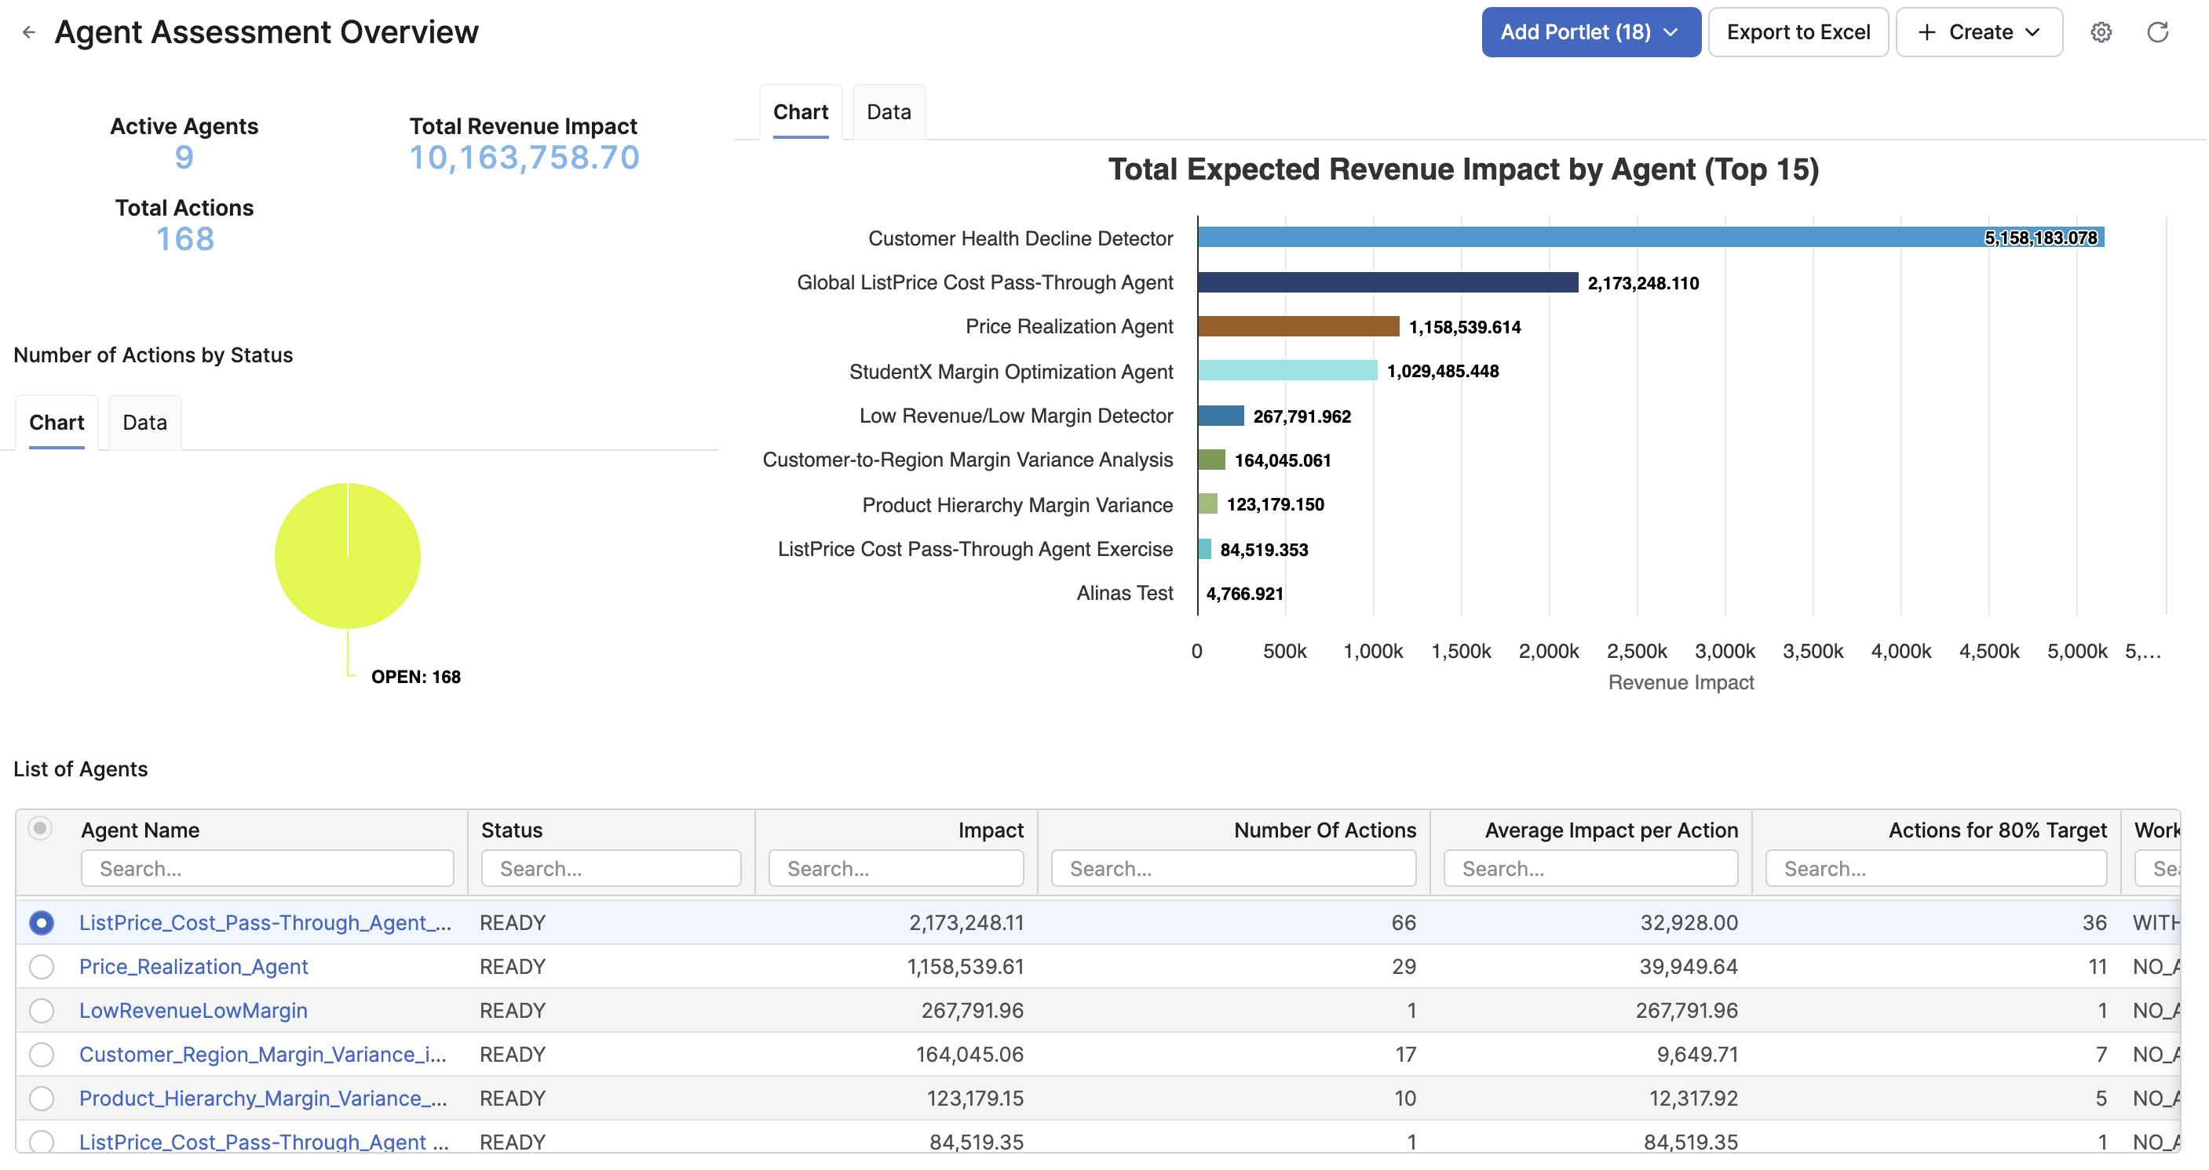
Pricefx Agents and Copilot
Identify opportunities, act fast and see immediate margin improvements.
Uncover business opportunities and risks on the fly
Identify business opportunities and risks immediately while utilizing Agents’ automation.
Get recommendations and act fast
Capture resulting value with a few clicks with the provided smart recommendations.
Start quickly with Pricefx Agents
Get to value quickly with Pricefx Agents, designed for typical business scenarios and pricing situations.
Meet your needs precisely with tailored Agents
Fit your specific needs and just ask Pricefx Copilot to create tailored Agent while using just natural language.

Slide 7
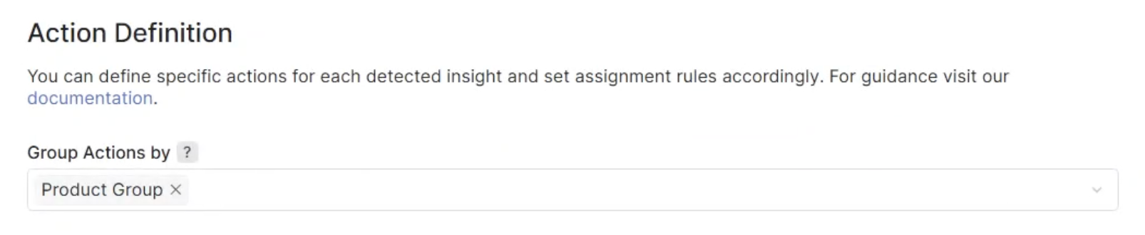
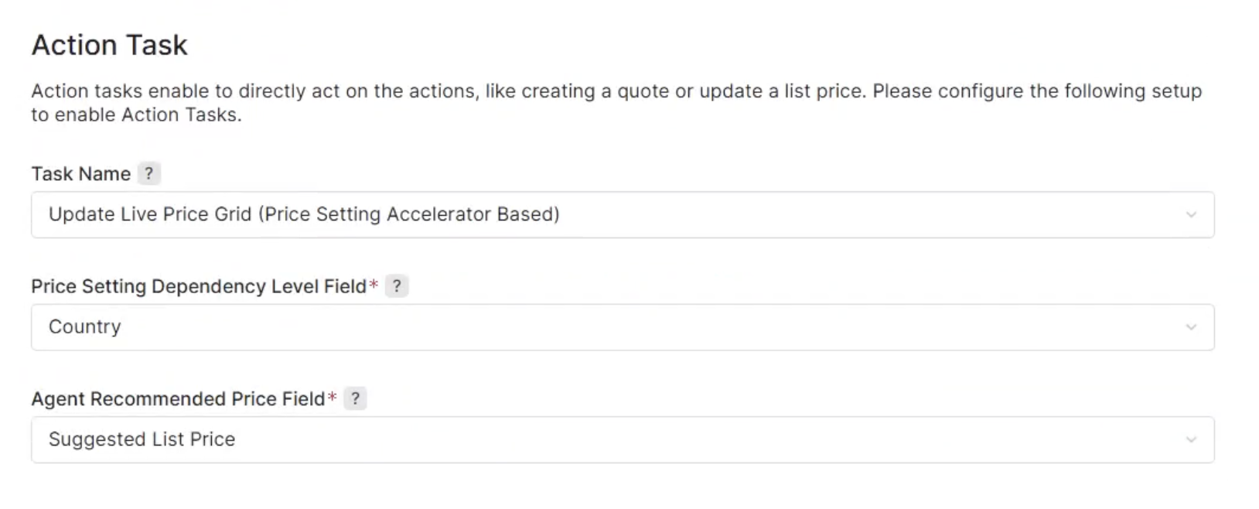
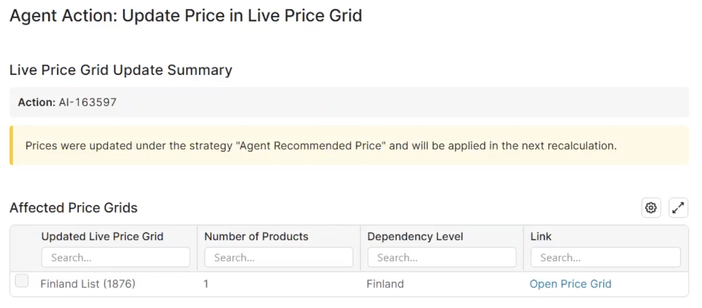
Actions Grouping and Action Tasks
Speed up decision making and act immediately.
Reduce noise and speed up decision making with Actions grouping based on a selected dimension (e. g. product group).
Assign Actions efficiently to relevant assignees while using the same dimension.
Act immediately on the Agent’s recommended Actions with contextually relevant Tasks (e. g. Quote creation or Live Price Grid update).
Fit your needs precisely and get the most relevant recommendations through the flexible settings of Actions and Action Tasks.

Slide 8
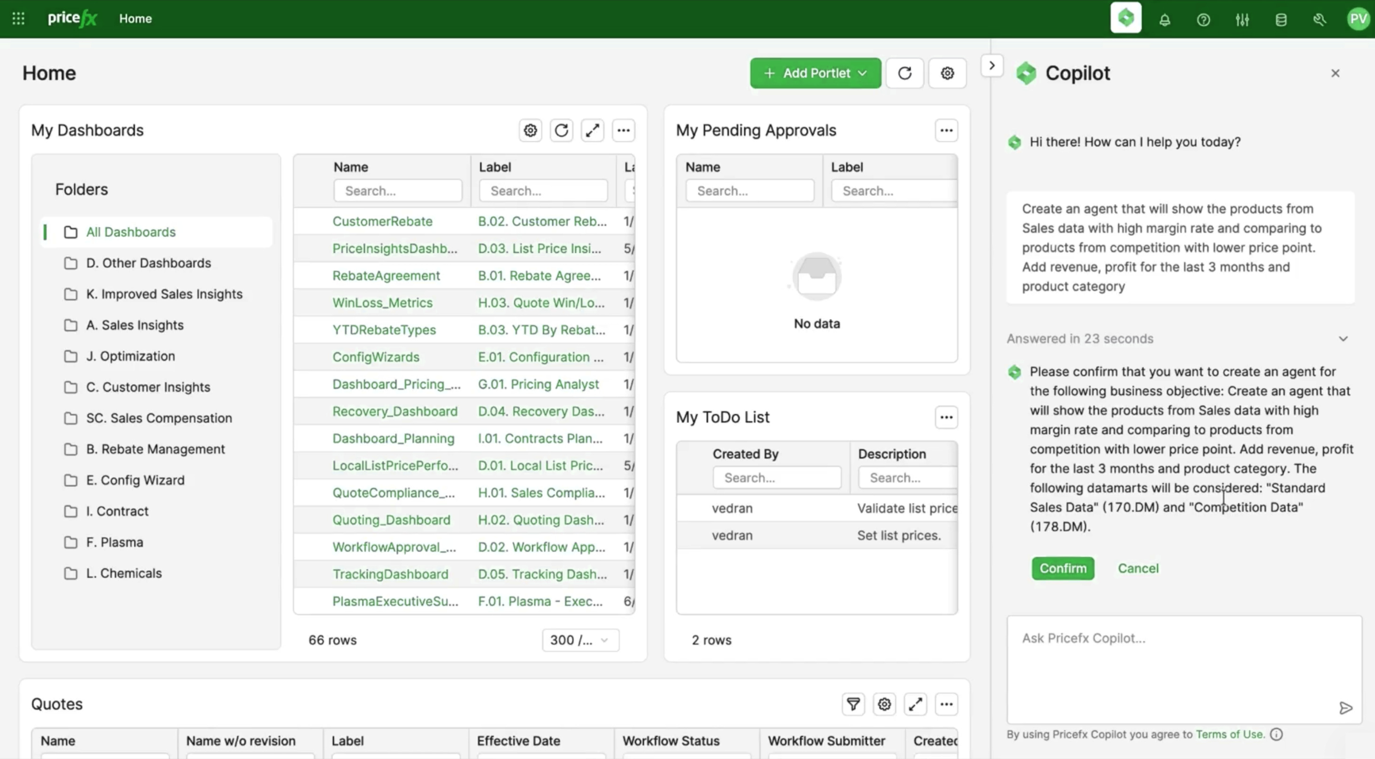
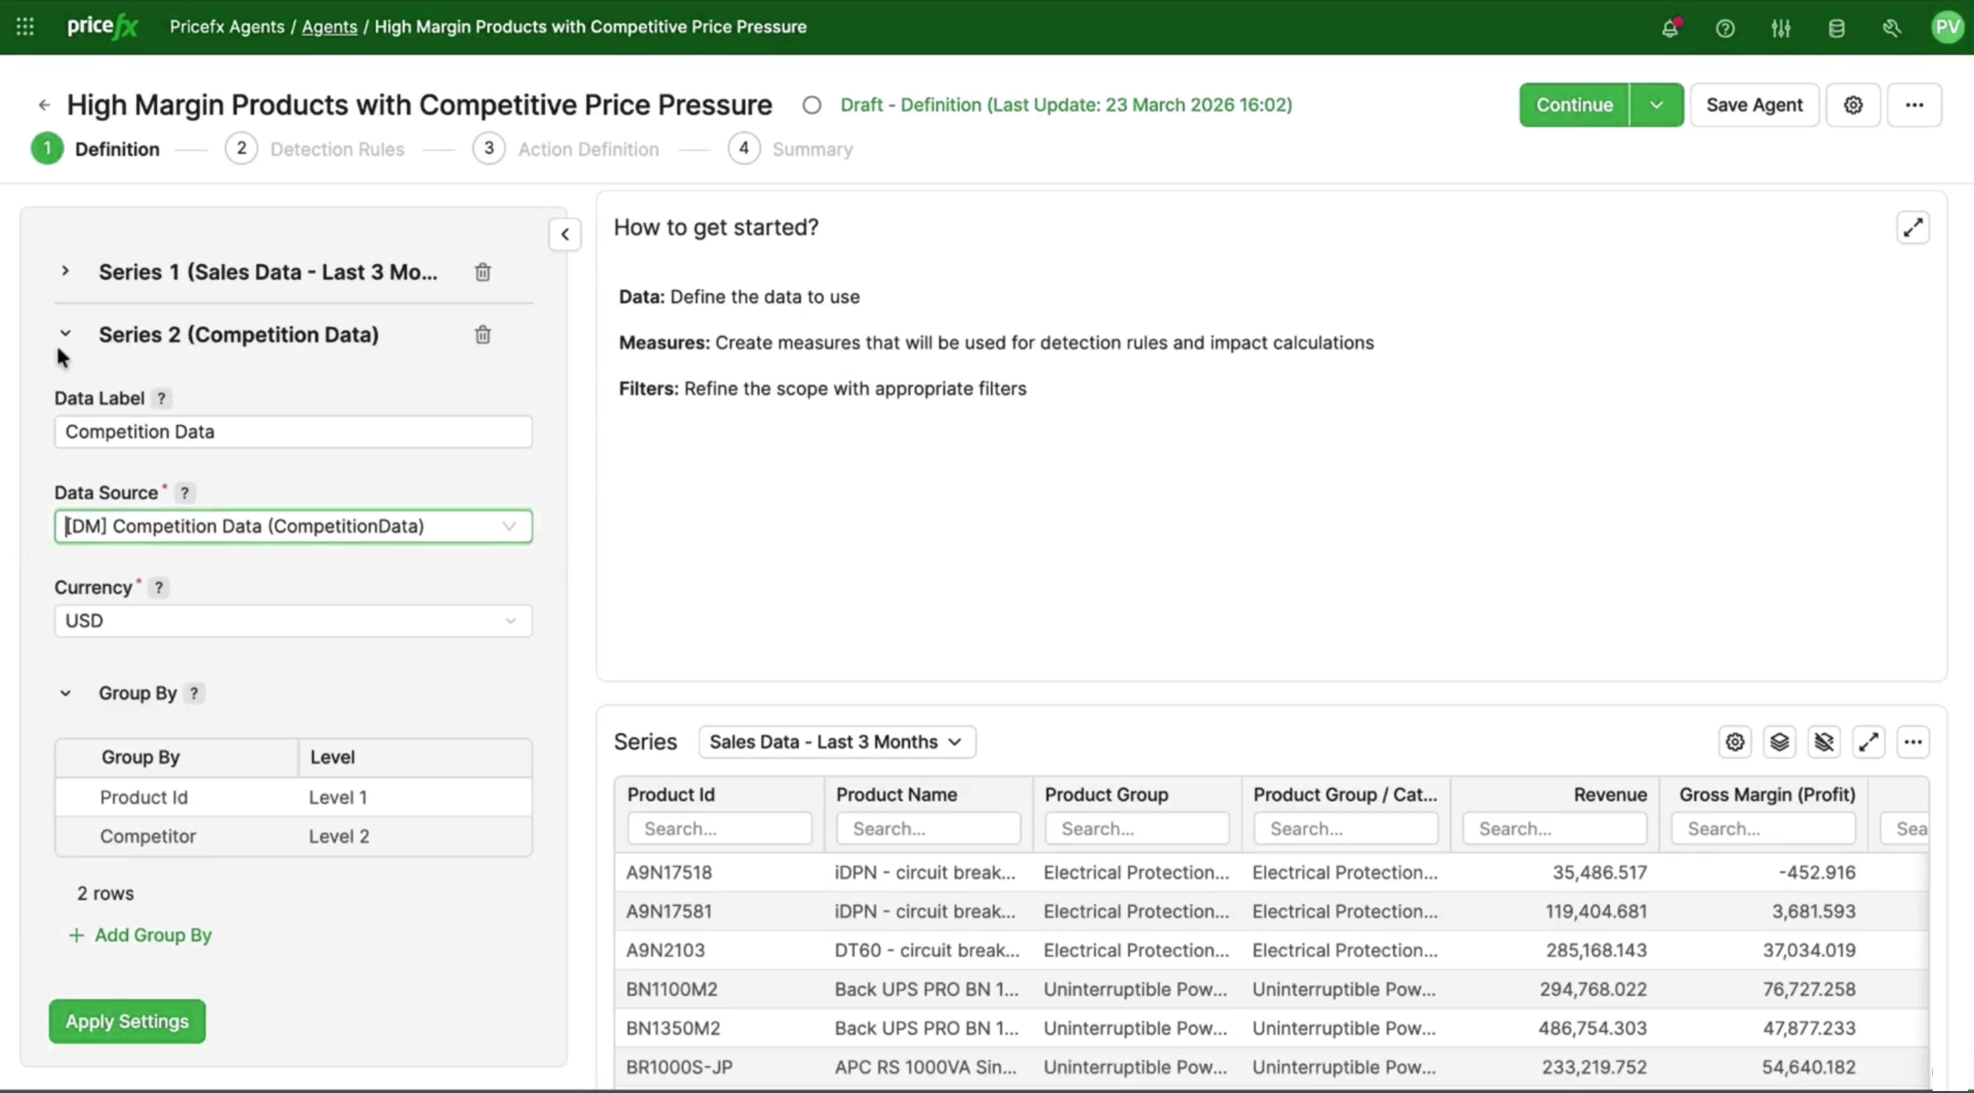
Agents Empowered by More Data
Uncover more opportunities with Agents working across various data sources.
Use just natural language and ask Copilot to create Agent with the access to data from multiple Datamarts simultaneously.
Copilot scans your available Datamarts and automatically selects the best-matching data based on the context of your request.
Name explicitly specific Datamarts in your prompts, ensuring the Agent uses the exact data sets you require.
New validations give you clear view on missing sources to prevent potentially misleading results.

Slide 9

AI Optimization

Slide 10
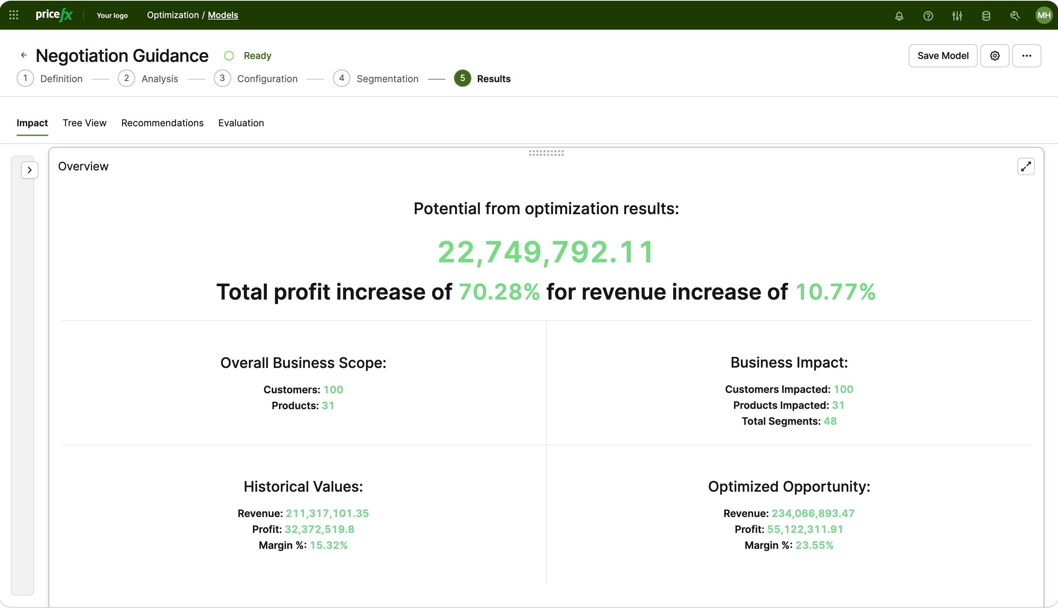
AI Optimization Use Cases
Align pricing with your strategic objectives and boost profit.
Negotiation Guidance
Turn deal data into confident and consistent negotiation guardrails that protect margin.
List Price Optimization
Strategically set list prices to unlock margin, align pricing with value and competitive moves.
Win Rate
Optimize prices to increase deal win rate while maximizing expected revenue and profit.
Product Recommendations
Guide sales teams toward the right products to improve quote outcomes and order value.
Price Waterfall Optimization
Optimize price realization by systematically improving every layer of the price waterfall.

Slide 11
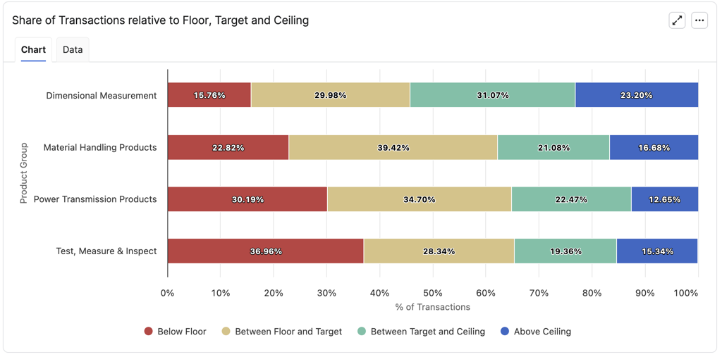
Enhanced Negotiation Guidance
Boost profit growth and get more transparency on deal pricing recommendations.
Price Index and Unit Net Price are introduced as two new optimization metrics.
A new Review dashboard uses specialized charts to quickly assess recommendation quality and provides better metrics to highlight segments to review.
The update adds Currency support with automatic conversion for Datamart sources.
New recency weighting prioritizes current transactions over older reference data.
Improved weight consistency and weighted percentiles provide more accurate optimization targets.

Slide 12
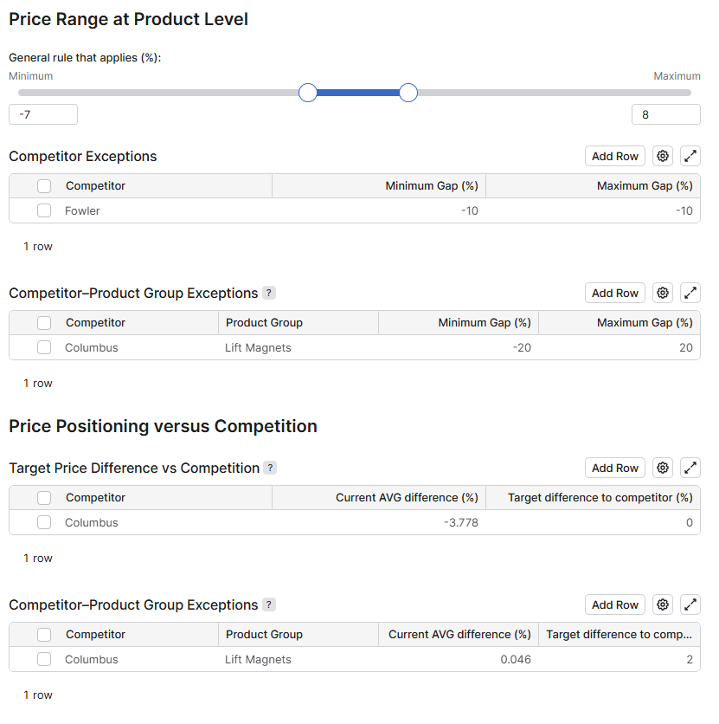
Enhanced List Price Optimization
Align pricing with competitive moves in granular or comprehensive way.
New competition positioning integrates rival pricing data into list or invoice price levels for comprehensive market alignment. Options:
  Product-based positioning enables granular rule-setting to differentiate your price strategy by specific product lines and individual competitors.
  Overall positioning establishes a unified stance by defining a strategic price relationship against key competitors across your entire portfolio.
Competition comparisons provide clear visibility through specialized views to track your market standing.
Alternative elasticity data introduces the flexibility to incorporate proprietary insights for more precise price sensitivity modeling.

Slide 13

Import Manager

Slide 14
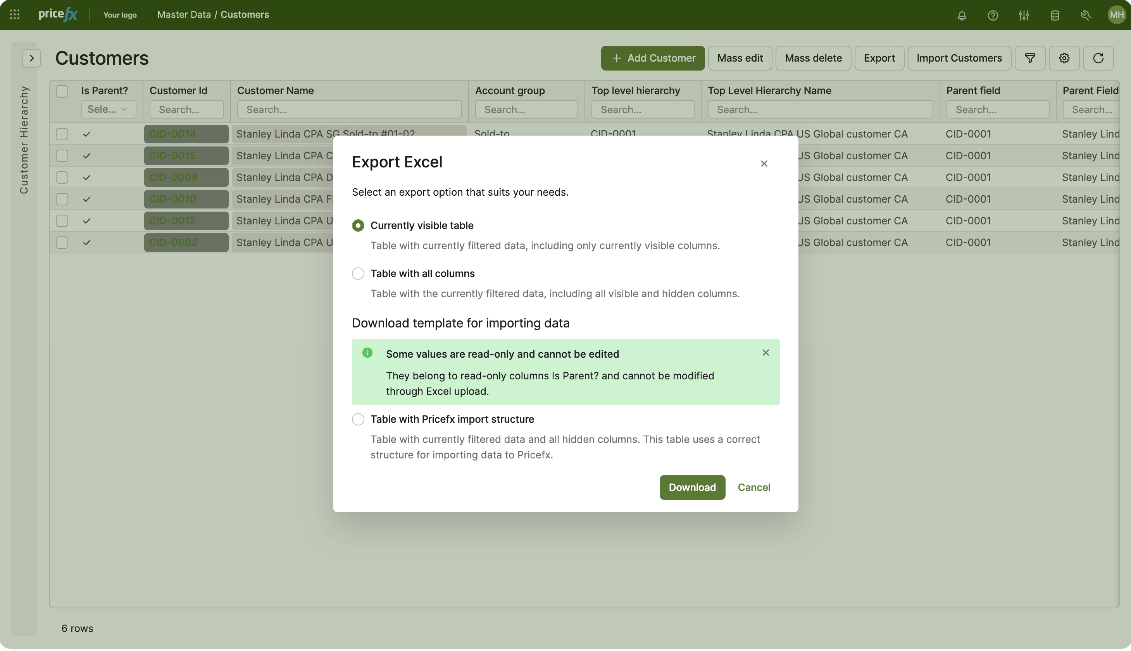
Import Manager
Manage data with in-app, governed and more intuitive approach.
Import data across the application
Manage everything from Price Lists and Master Data to Company Parameters and Bill of Materials directly within the Pricefx app without needing additional tools.
Perform data validations
Faster and error-free data updates with identification of mismatched rows and execution of bulk edits.
Utilize approval workflows
Gain better control over your business data by ensuring all data imports are subject to approval workflow.
Modernize your data management
Adapt a simpler, more intuitive in-app alternative to the Pricefx Excel client.

Slide 15
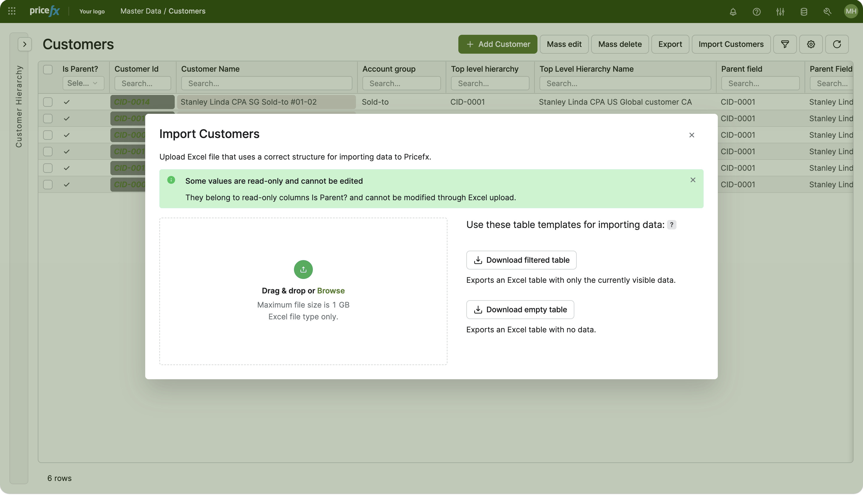
Import Manager’s Key Capabilities
Add, update, validate and export data directly from within Pricefx application.
Simple export/import workflow using pre-structured templates and easy drag-and-drop file uploads.
Integrated validation and error handling that highlights issues for correction before data is finalized.
Governance enabled by approval workflows, ensuring changes are reviewed and authorized before being applied.
Centralized tracking and audit trails to monitor the status of all current and past imports.
Direct import brings in data quickly to tables where no verification and approval is needed.
Create new option allows in-app creation of your import and data update.
New

Slide 16
All the Data Supported
From Price Lists and Master Data to Company Parameters and Bill of Materials.
Products and Customers master data
Product / Customer Extensions
Product References
Company Parameters
Sellers and Seller Extensions
Competition Data
Bill of Material data
Price Lists data
Manual Price Lists data
Live Price Grids data

Slide 17

Deprecating Features

Slide 18
Deprecating Features
Pricefx Excel client and Data Change Request feature will be deprecated.
Consolidation of legacy tools
Pricefx is deprecating both the Excel client and Data Change Request, moving all functionality into the single, modern Import Manager solution.
Timeline
Customers should start using Import Manager before upgrading to release 17.0, as these legacy tools will be fully removed.
Enhanced governance and performance
The transition offers better scalability and performance alongside built-in validation and native workflow approvals, ensuring controlled and traceable bulk data changes.
No loss of capability
This change is a platform upgrade rather than a loss of features, as Import Manager covers all existing use cases—including master data updates and governed changes.

Slide 19

Other Enhancements

Slide 20
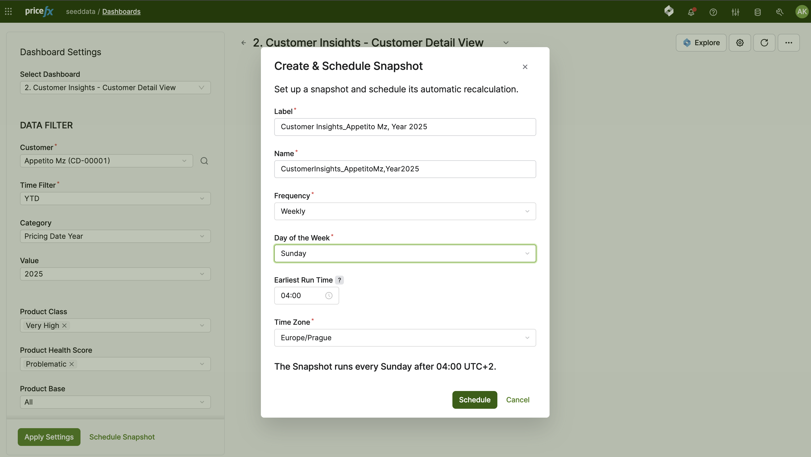
Dashboard Snapshots
Save valuable time with scheduled pre-calculation of important dashboards.
Schedule dashboards with specific filters to be pre-calculated automatically.
Instant access to critical metrics based on heavy data without any processing lag.
Seamless and professional executive reporting or KPI reviews by having your data calculated in advance.
Generally available with release 17.

Slide 21

Background Recalculations
Save time with background recalculation of quotes and agreements.
Recalculations now run in the background, meaning the UI no longer freezes and you can continue working on other tasks or documents without interruption.
Spot a typo? You can now stop an active calculation immediately to fix errors, saving you from waiting for a flawed process to finish.
Gain better control with document-specific settings. You can now tailor how calculations behave for individual header types, such as separate rules for quotes versus rebates.
Available for Quoting, Agreements & Promotions, Rebates and Sales Compensation.

Slide 22

Data Validation in PlatformManager
Validate data independently with enhanced Data Validation tool.
Select and fine-tune validation checks (e.g., Product, Transactions) for new data uploads or existing files to match your specific business context.
Inspect file contents directly in the tool to ensure accuracy without downloading.
Identify the right datasets by seeing where and how selected files were previously used.
Automatically align file columns with Pricefx structures using intelligent mapping steps.
Monitor quality via dashboards, drill down into specific errors, and download full reports.
Revisit, re-run, or download results from past validation processes.

Slide 23
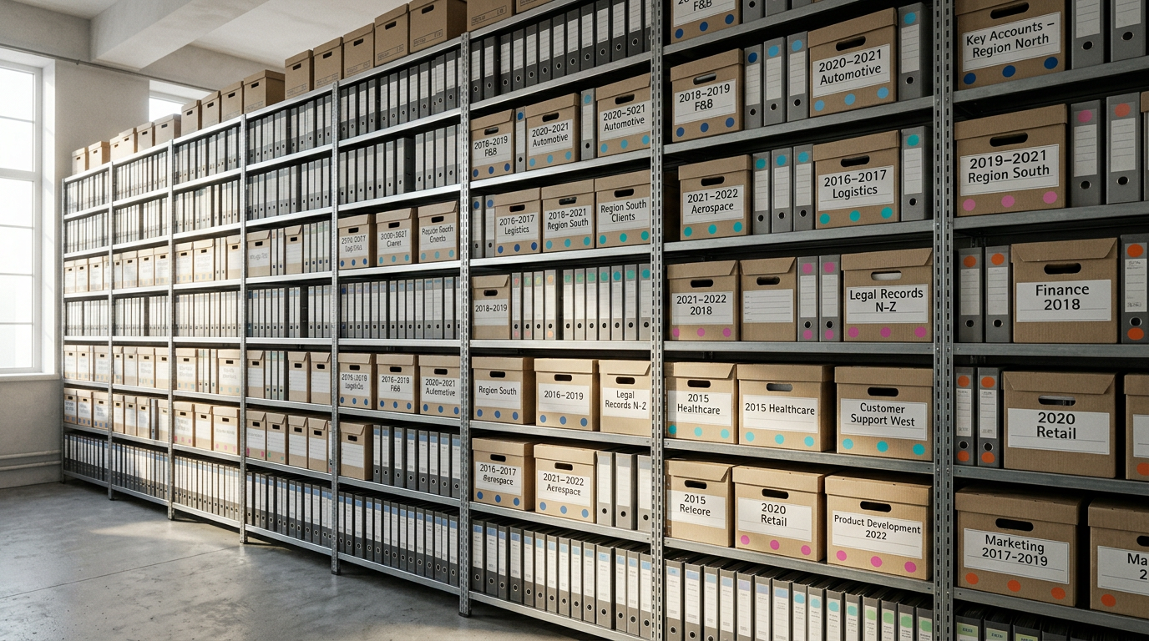
New Knowledge Base

Slide 24
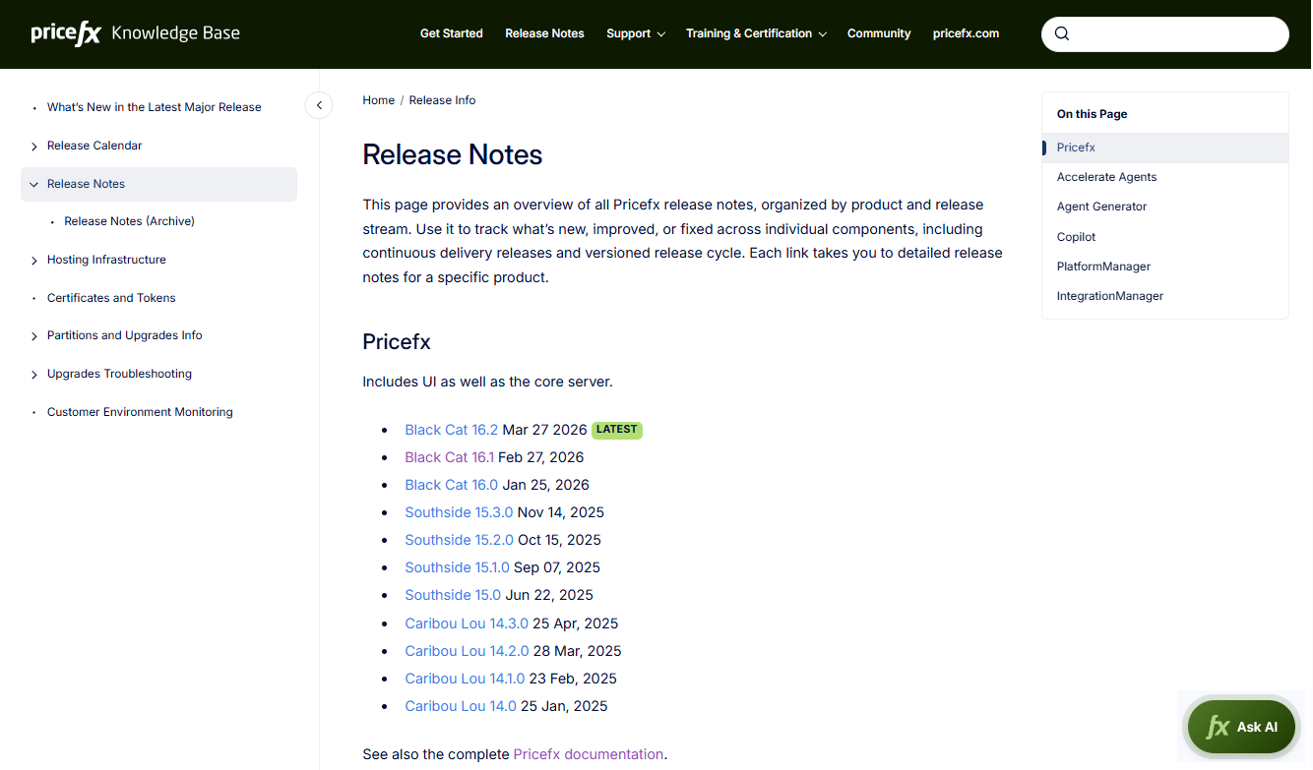
All-New Pricefx Knowledge Base
Search faster in Pricefx Knowledge Base with new AI-powered features.
The all-new Pricefx Knowledge Base allows to search for Pricefx related information faster and is built to be fully AI-ready.
An embedded AI chatbot help users find specific answers in record time.
Engineers can use a new MCP server to plug documentation directly into their IDE.
URLs to Pricefx Confluence a current Knowledge Base version
  Existing Confluence links will stay active and continue to work as usual.
  Existing Knowledge Base URLs will change - moving to a cleaner format without page IDs.
The all-new Knowledge Base is officially launching on April 14th at knowledge.pricefx.com

Slide 25

Pricefx N-1 Release Policy

Slide 26
Pricefx N-1 Release Policy
Pricefx provides official support for the latest 2 releases.
Pricefx provides official support for the latest 2 releases. Currently, Southside 15.x and Black Cat 16.x releases meet this condition.
Once the Paloma 17 release is made available, all our customers will be required to use Paloma 17.x (N release) or Black Cat 16.x (N-1 release).
If you are on the Southside 15 release, we encourage you to start planning for the upgrade to Black Cat 16 already now.
Important primarily for Customers hosted in Private cloud environments. Customers hosted in Shared environment are upgraded automatically and comply with the policy.

