Slide 1
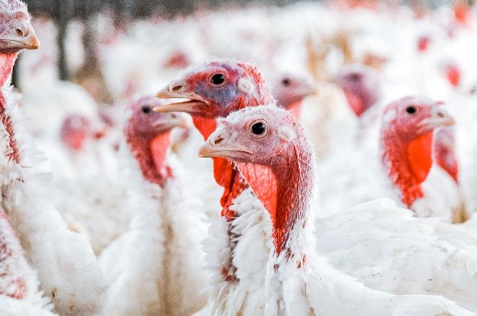
Making Us Sizzle, Again
Exploring new opportunities and efficiencies through pricing.

Slide 2
Facing the Facts: Foodservices Industrial Spending Down 28.4% in 2020*
COVID-19 has had and will continue to have a dramatic effect on food processors. The entire food industry has been shaken up. There’s an increase in retail demand (with everyone
cooking at home) and a slowdown in food processing (especially in restaurants and hospitality).
But is cutting costs or raising prices really the only way to get through it?
*According to the International Foodservice Manufacturers Assn. August, 2020 report.

Slide 3
There are both external and internal factors that can lead to margin leak. Finding out where we are leaking money is the first step in minimizing the loss.
Where does Margin Leak Come From?

Slide 4
Currency Fluctuations
Exchange rate fluctuations and a decline in export and import activity are having an effect.
Commodity & Energy Fluctuations
Energy and commodity price fluctuations and raw material shortages are creating slowdowns.
Increased Safety Requirements Huge undertaking and cost to enhance employee safety and plant sanitization measures.
Labor Disruptions
Despite a big win for workplace health, increased employee illness may continue to be an issue.
External Factors Gobbling Up Profit

Slide 5
Lack of True-Cost Awareness Discounts. Commodity increases. Marketing spend. Are you really keeping track of all the costs?
Rebates A Mystery to Sales
A sales team who doesn’t understand the rebates your company offers could lead to lost revenue.
Lack of System Integration
You can’t get accurate data for all sides of your business if your systems don’t work together.
Slow & Inaccurate Customer Quotes
A lack of goal alignment between departments can impact how fast your sales team can quote.
Internal Factors At Play

Slide 6
The Value of Solving
Margin Leakage
A recent McKinsey study found…
A 1% increase in price (if demand stays consistent) increases operating profit by an average of 8.7%. Which means the opposite also holds true.
So instead of discounting prices, what can be done?

Slide 7
How to Minimize Loss and Improve Margins. Yes, Even Now
Start with data. Get a clear understanding of where money is leaking and how much revenue is gained from every transaction.
Gather intelligence. Avoid the hype and rely instead on what customers are saying.
Don’t rush to drop prices. Pricing software can help you find weaknesses and opportunities.
Test for full visibility. Testing different market strategies shows you exactly how any small change will impact your bottom line.
Launch your strategy. Choose the
best test strategy for your overall goals and circumstances.

Slide 8
What About Our Customers?
One of the best ways to help customers is to understand their mindset. Let’s look at some of the ways food operators are looking to respond and modify their business models post-pandemic.

Slide 9
What Your Foodservice Operators Want Right Now
Greater transparency and tracking to understand their supply chain and sourcing risks. This is a move many operators have already taken and will continue to take.
Increased focus on disaster planning, including contingency planning and risk mitigation.
Increased domestic and local sourcing to reduce the risk and dependency on foreign suppliers.
More partially cooked, ready-to-heat food solutions that lower labor requirements.
Stronger long-term relationships with suppliers to reduce risk and avoid costly changes.

Slide 10
Questions We Need
to Be Asking
Do we understand exactly how much revenue is gained from each sale? Is our current pricing process accurate and efficient?
Do we know where there are margin leaks in our sales process? Do we have the pricing insights to lock in long-term contracts? Are we ready to explore a new pricing strategy?

Slide 11
1%-5%
revenue increase
What Analysts Say About Cloud-Based
Pricing Solutions
2%-10%
margin increase
20%
lifetime value increase
Source: Gartner: March 2018 Market Guide for B2B price optimization and management software.

Slide 12
A Pricefx Foodservices Expert Can Help
Carolina Alvarez
Business Development Representative Pricefx
Phone: 1-408-596-6858
Email: carolina.alvarez@pricefx.com
Ryan Fritz
Sr. AE, Food & Beverage Pricefx
Phone: 1-360-518-4236
Email: ryan.fritz@pricefx.com
Pricefx is a cloud-based pricing software that helps seal the leaks, optimize pricing and ultimately increase the bottom line. Speak to an expert today.
Pricefx.com

